Slide 1




AGM
ANNUAL REPORT
2022

Slide 3
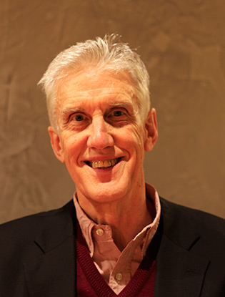


CHAIRMAN’S REPORT
PROFESSOR IAN HOWIE

Slide 4

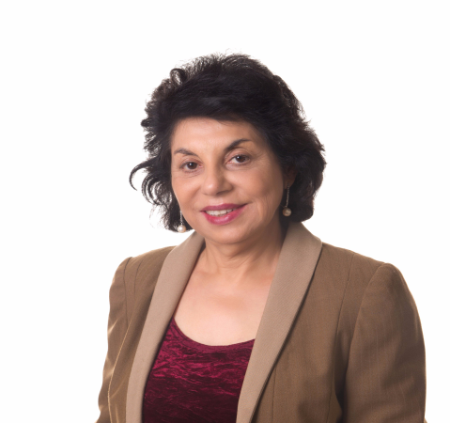
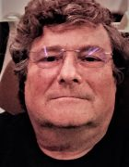
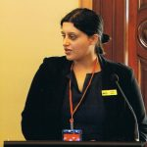
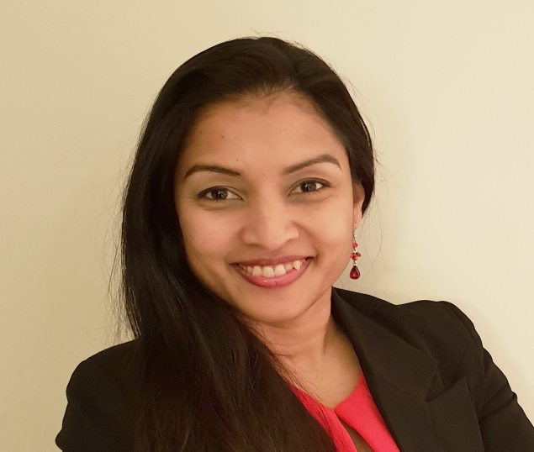
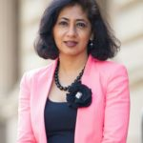
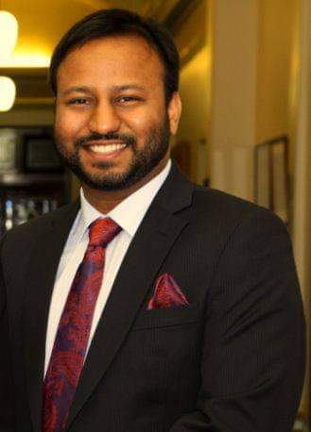
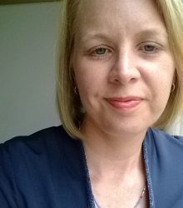
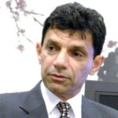
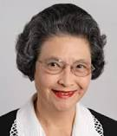
ACHRH BOARD 2021-22

Slide 5

Audited Income and Expense Statement
For the year ended 30 June 2022

Slide 6
INCOME
2022 | 2021
Grants 167,974 | Grants 113020
Donations 21,380 | Donations 36,100
189,354 | 145208

Slide 7
Expenditure
2022 | 2021
84,727 | 19,743
Surplus 104627 | Surplus 125,465

Slide 8
Assets and Liabilities Statement
Assets

Slide 9
Special thanks to
Auditors Speedacc Consulting and book keepr Ms Nyein Nyein for preparing the financial statement

Slide 10
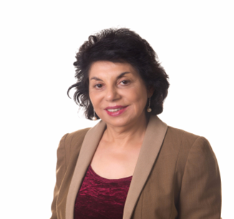
EXECUTIVE DIRECTOR ‘S REPORT
PROFESSOR MANJULA
DATTA O’CONNOR

Slide 11
ACHRH –Advisory and collaboration
Advisory capacity - Suicide Prevention working group Whittlesea region, Crossroads to Community Wellbeing Working Group 1800Respect , Full Stop Australia, DV Alert -Life Line
Combined projects- University of New South Wales , Sydney Australian Indian Medical Graduates Association, Harmony Alliance. Brotherhood of St Lawrence Epping , ISCKON (Hare Krishna Temple) , Casey Gurdwara , Oorja Foundation
In India – National Institute of Health and Family Welfare , Delhi
The SOUTH ASIAN COMMUNITY

Slide 12
Achrh influence on policy
Supported the NSW coercive control legislation development, made a submission, invited to give evidence to NSW Parliamentary Hearing
Invited by the Federal AG to round table discussion on coercive control legislation.
Dowry abuse recognized as a form of domestic abuse in National Plans to prevent domestic violence 2012-2022, 2023-2033
Dowry abuse recognized in the Victorian FV Prevention Act 2019

Slide 13
Achrh chairs the National dowry abuse working group
.Membership- Good Sheperd , Intouch Multicultural centre, Harmony Alliance and UNSW
The group TOR include- highlight the nature and impact of dowry abuse , prevention of dowry absue, advocating for legislative changes to include dowry abuse at Federal level and States.
Regular meetings are held with relevant Govt authorities and Attorneys General .

Slide 14
Achrh contributes to knowledge base
All community projects are put through Human Research and Ethics Committee. Contribute to Communy Based Participatory Research
January 2022- paper in Medical Journal of Australia on “Health Impacts of dowry abuse
In 2022 the Executive Director was invited by AIFS on behalf of Respect Victoria to write a paper on literature review on - dowry abuse , forced marriage and FGM
Published Blog on UNSW website as part of Blogatahan during #16daysofactivism on “Dowry absue and Exit Trafficking “

Slide 15
Project Work 2022
Mutual Relational Respect workshops since 2012
National dowry abuse prevention education campaign 2020-2022
Sneh community participatory theatre project. 2021-2024
Three monthly ACHRH Newsletter

Slide 16
Mutual Relational Respect workshops since 2012
The migration experience involves a complex combination of losses and opportunities. The migrants leave their homeland, family and friends, traditions and culture.
Migrants arriving in Australia can be isolated, disengaged, making them vulnerable to domestic violence, and related mental health issues . Yet there are few opportunities for migrants to learn about the new cultural system they are entering, or more particularly explore deeper understanding of social norms and notions of gender equality.
ACHRH has identified and been working to address this gap for about a decade. In 2013, ACHRH implemented the Mutual Cultural Respect training project
it won the Victorian Govt Multicultural Award for Excellence award for COMMUNITY INNOVATION
Suitable for new migrants

Slide 17





Slide 18
2017-2023 ACHRH awarded DSS funding to extend MCR training to primary prevention :
MRR project was conceptualized
How- The MRR project explores how women and men use their local cultural references to make sense of domestic violence they have experienced or witnessed. It uses adult learning principles respecting and builds on the knowledge and life experiences of adult participants in interactive workshops
What - The workshops address primary prevention of violence against women through providing opportunities to discuss health relationships and lifestyles, shared decision-making, enhanced harmony and equality, and championing the fight against family violence.
Funding renewed third time 2022 – to conntinue into 2023
Suitable for University/TAFE students , and adults

Slide 19
Evaluation
2021 proved challenging due to covid.
We improvised and turned the in person workshops into Zoom meetings.
The MRR project delivered 10 workshops to a range of South Asian community groups and professional in 2021-22 across metropolitan Melbourne, Wodonga and Sydney. And 11 workshops on 2018-19
MRR workshop format is well accepted, leads to enhanced knowledge around nonphysical forms of FDV , help seeking sources , what drives FDV and helps challenge attitudes.
. Awareness of mental health and suicidal behaviours , how to self-help and help others and get professional help at the earliest.

Slide 20
Dowry Abuse prevention campaign
A grant over three years with Harmony Alliance started in 2020-2022
AIMS- Engage and upskill migrant and refugee community leaders to raise awareness of dowry abuse in their communities, counter attitudes that condone violence and increase the ability of community members to address and prevent dowry abuse within their relationships, families, and communities.
To achieve this, the project adopted an intersectional community-led, co-design approach, alongside a culturally tailored, trauma-informed and intersectional method.
In being intersectional, the project acknowledged the diversity of experiences of people from migrant and refugee backgrounds with awareness of the intersecting impacts of gender for women

Slide 21
National Dowry Abuse Prevention project Output
Conducted 5 focus groups, ran a national survey tragetted at the South Asian community around the prevalence of dowry abuse in Australia
Prepared national workshops titled : Demand Equalty not dowry “
Trained 15 trainers nationally to run the workshops -36 workshops were conducted
Produced an academic paper on “Heath Impacts of dowry Abuse “ published 2022 in MJA
Grant extended into 2023 -24 to scale up the ouput to reach thousands

Slide 22

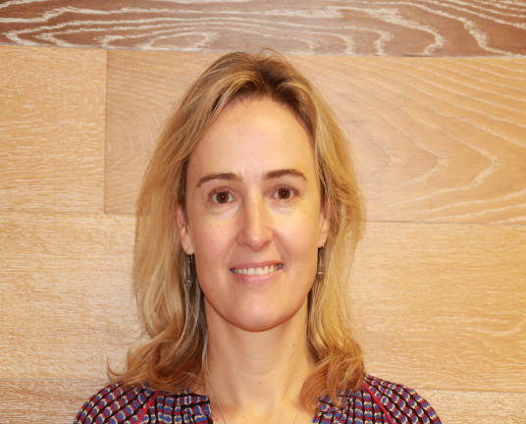

ACHRH NEWSLETTER
Thank you Gauri Kapoor and Kristin Aitken !
3 newsletters produced annually

Slide 23
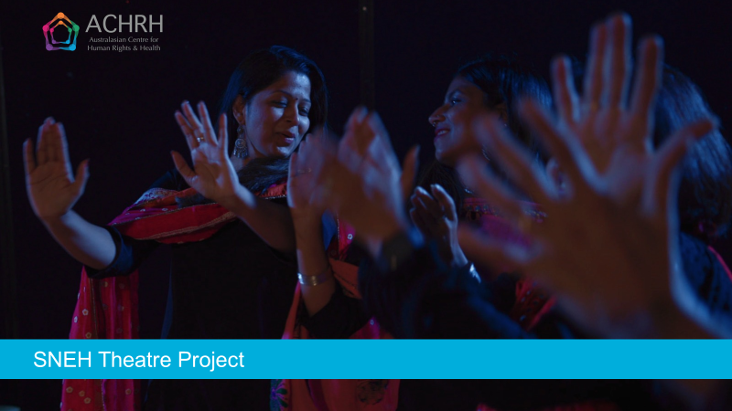
FLAGSHIP PROJECT 2022

Slide 24
About the grant program
The objectives of the Supporting Multicultural and Faith Communities to Prevent Family Violence 2021 Program are to:
deepen and expand primary prevention and early intervention activity with multicultural and faith communities
continue to build and enhance the collective knowledge of successful primary prevention and early intervention activity and intersectional practice
strengthen the capacity of organisations working with multicultural and faith communities in primary prevention and early intervention activity
improve the identification and response to victim survivors of violence by better joining primary prevention activity with early intervention activity in a wide range of settings.

Slide 25


SNEH Theatre Project
in partnership with the Oorja Foundation
Film director and photography: Emma Macey-Storch
Evaluation:
Approved by the Melbourne Clinic Research Ethics Committee
Funded by the Victorian Department of Families, Fairness and Housing under the ‘Supporting Multicultural and Faith Communities to Prevent Family Violence’ Grant Program

Slide 26
About the grant program
The Supporting Multicultural and Faith Communities to Prevent Family Violence: 2021 Grant Program under the DFFH
The Program will contribute to the Victorian Government’s vision to create a Victoria free from violence,
The program uses Change the Story: A Shared Framework as the knowledge base to guide the scope of prevention activity

Slide 27
WHY COMMUNITY PARTCIPATORY THEATRE ?
Baesd on Forum Theatre invented by perfected by Augusto Boal(Boal, 1979).
USING CULTURE AS STRENGTH
Working with community and society it is crucial to improve strategies to address issues of social health, moving the locus of control from external agencies to the people who are directly experiencing it.
Theatre by bringing the stories of marginalized people on stage offers a rare opportunity to people on the fringe to be in the center where, being the experts of their own lives, they can be engaged in a dialogue with the audience to discover and explore collectively how to deal with their own problems.

Slide 28
CP Theatre gives the audience a part in the dramatic action
The community of participants creates and acts out a symbolic representation in which they witness their struggle and highlight the forms of oppressive conflicts within society.
The scenario runs once and is subsequently enacted again, encouraging the audience to stop the action and change the dramatic action replacing a character on the stage.
Discussion is promoted by the facilitator, with the aim to create a deeper understanding of the scenario and gain a critical awareness about cultural assumptions, beliefs and values. And acting ut potentially helpful alternatives

Slide 29
Creating the foundation of Sneh Theatre
The project first researched and explored the community’s understandings around gender norms, gender equality, and family and domestic violence
Two focus groups were conducted with community members
26 Indian community members participated
Key issues identified by the community included:
    Dowry abuse
    Family dynamics
    Migration issues and vulnerabilities
    Impacts of not seeking help
    Gendered drivers of violence

Slide 30
THE FIRST MEETING

Slide 31
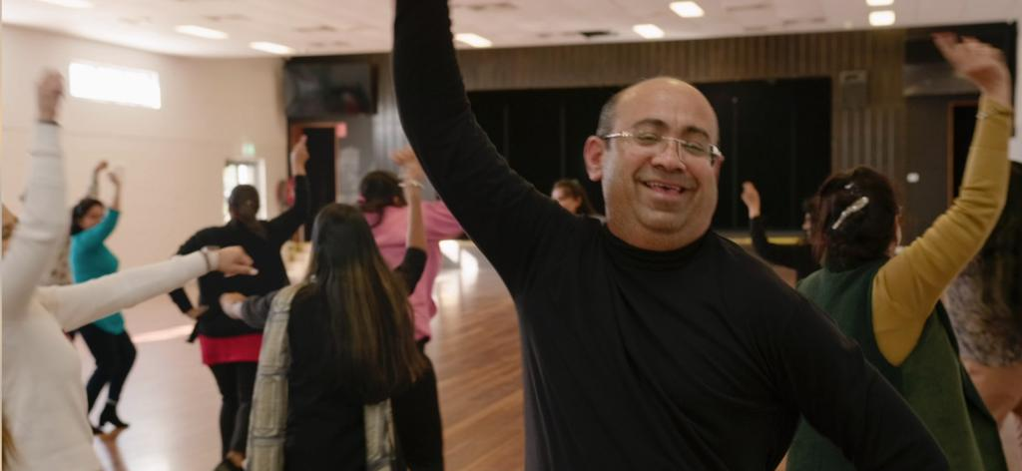
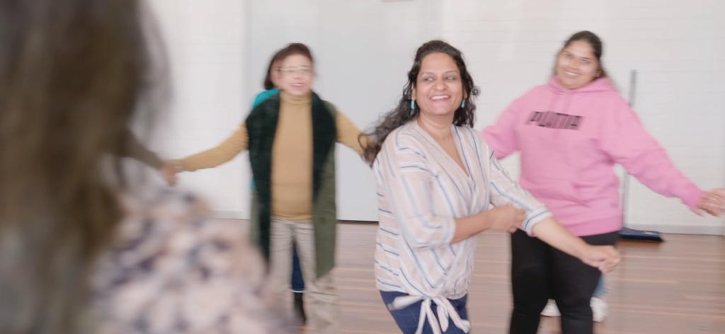
Community participatory theatre workshop
BUILDING TRUST
The purpose of the participatory theatre workshops was:
To build a theatre ensemble community group from volunteer participants
To address the issues raised in the focus groups

Slide 32
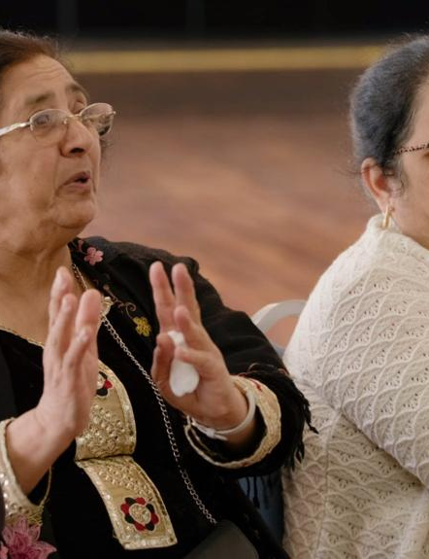
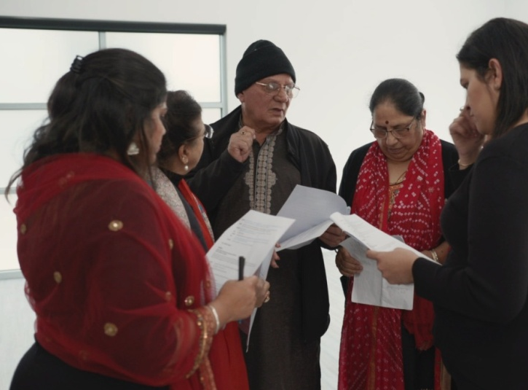
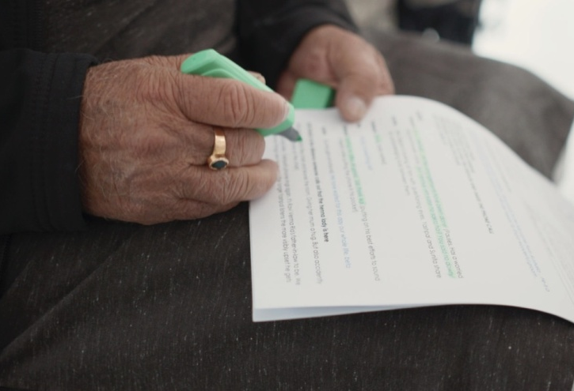
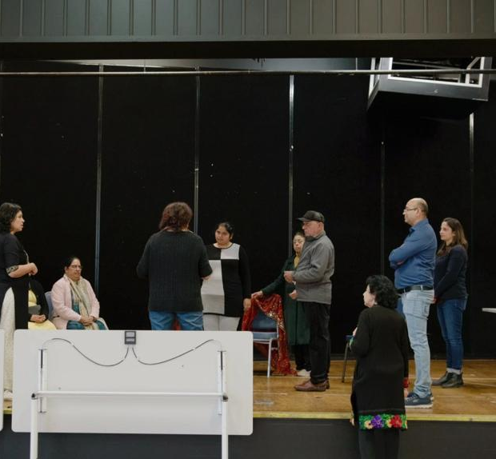
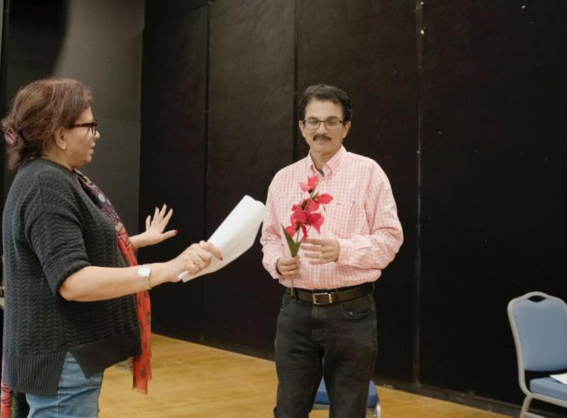
Development and rehearsals
16 volunteer members of the Indian community, together with members of the project team explore themes related to FDV , gender norms, stereotypes and help-seeking
Workshops and rehearsals were run over months, both face to face and online
The workshops dived deep into the themes around early intervention and primary prevention

Slide 33
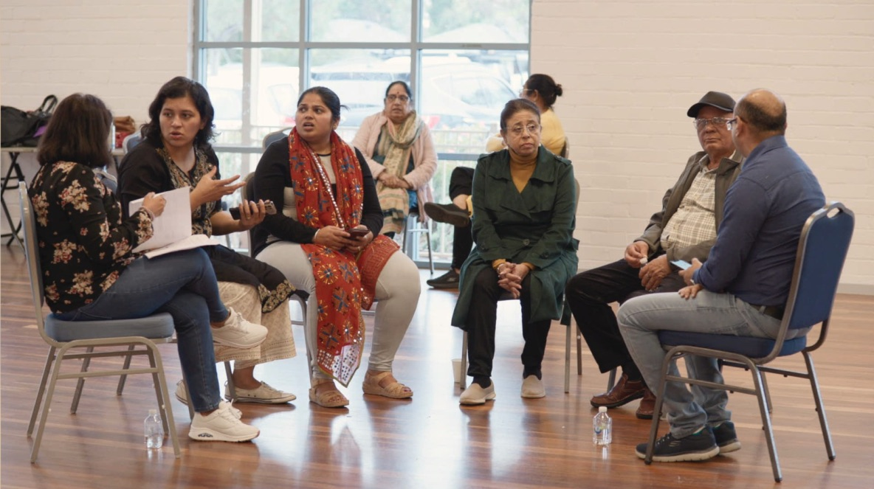

Slide 34
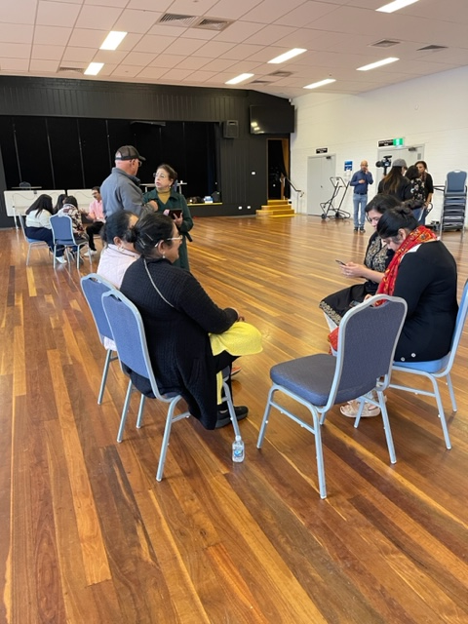
Workshopping

Slide 35
Complex project held together by “infra-structure” team, led by team leader

Slide 36
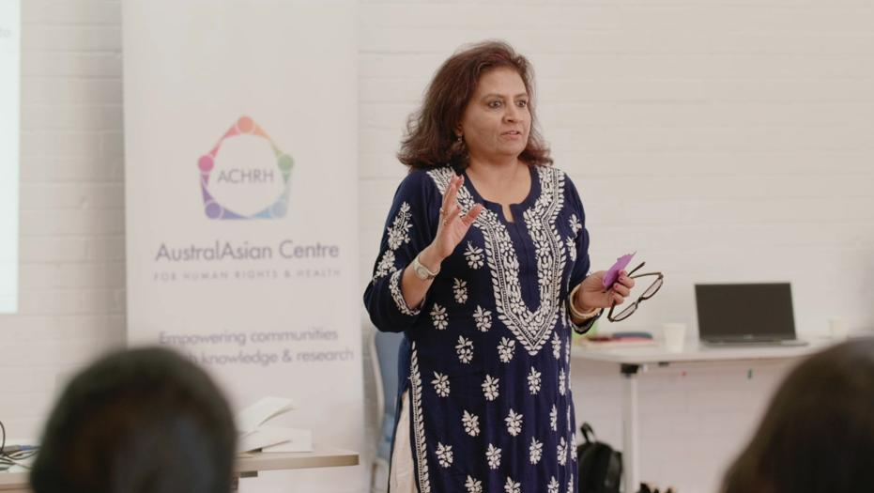
Led by the Theatre Director, and cultural consultants, the group developed and created working scenarios from community and participants’ stories

Slide 37
Three skits were selected for development
Dowry abuse
Migration pressures
Financial pressures that may increase the risk of family violence and the impacts on women and children
Benefits of early help-seeking is a key unifying scheme

Slide 38
SNEH – by the numbers
2 community focus groups, with 26 participants
9 members on the project team
14 – 19 community volunteers participated in 5 community workshops
3 community performances reaching approximately 80 audience members
Countless project meetings!
Continuous filming with embded film crew

Slide 39
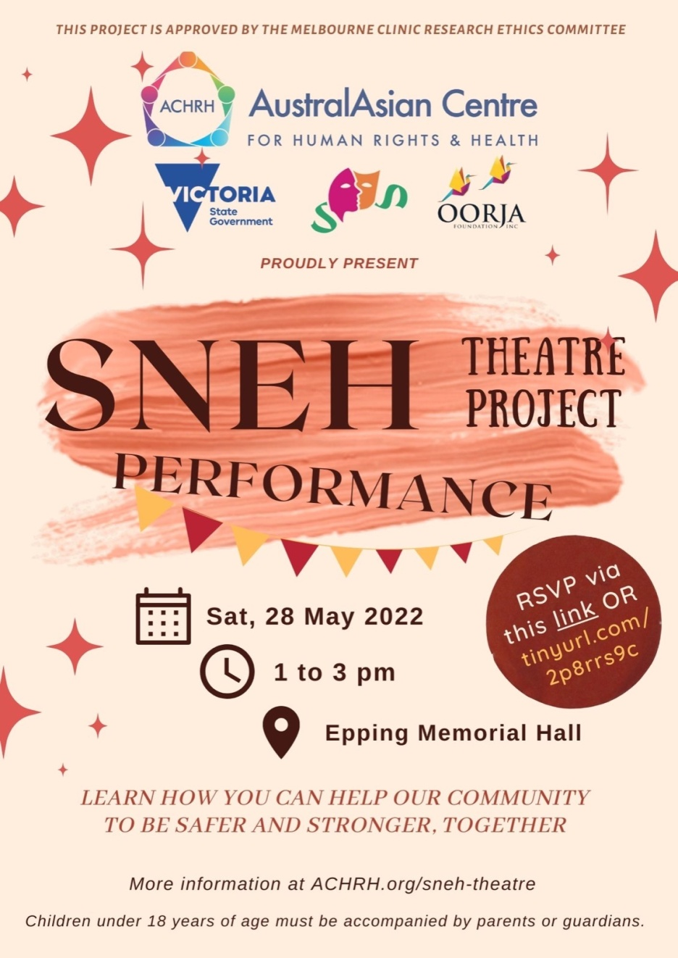
3 Community performances
May 2022: Epping Memorial Hall
Aug 2022: University of New South Wales (UNSW) Sydney
Nov 2022: ISKCON, Albert Park
2023: Four performances to be scheduled

Slide 40
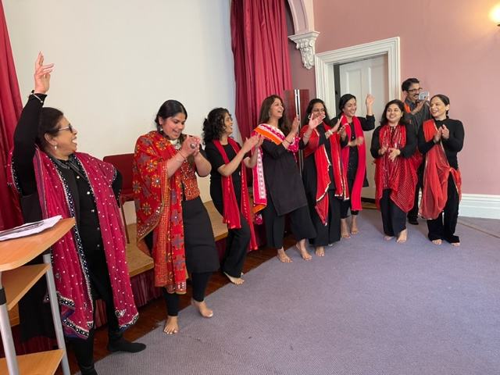
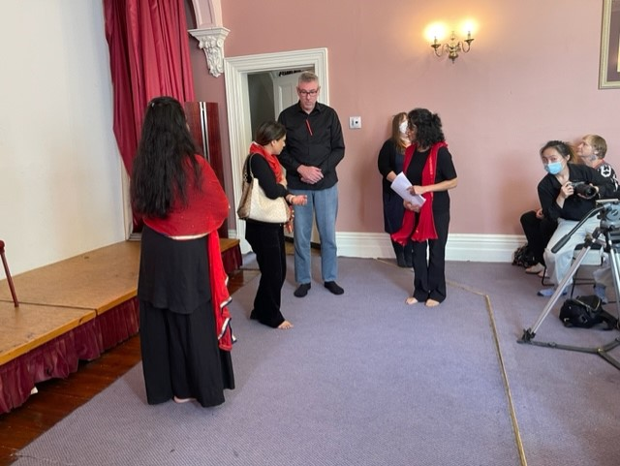
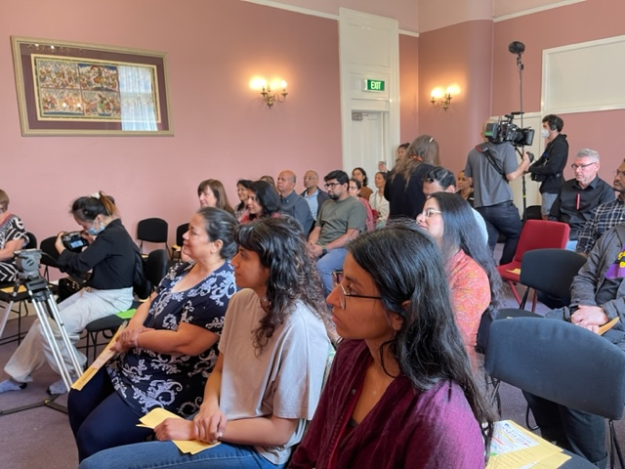
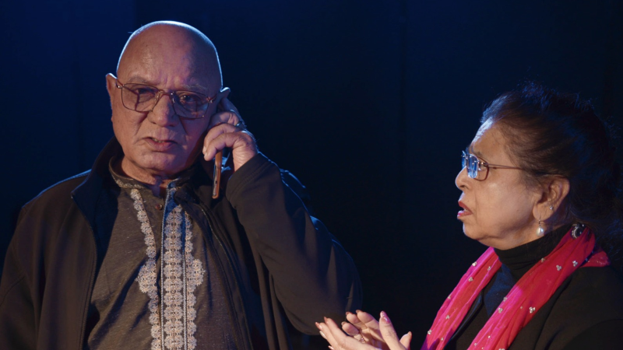

Slide 41
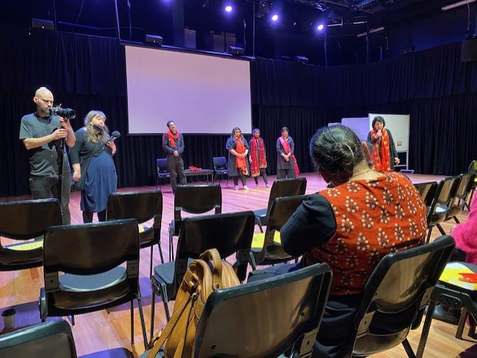
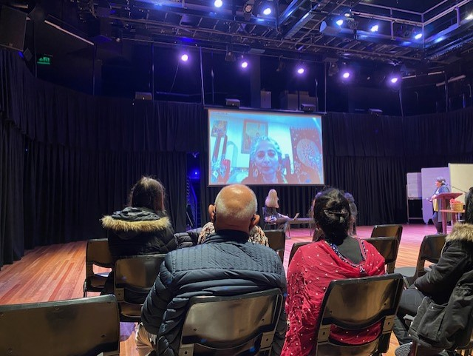
UNSW Performance

Slide 42
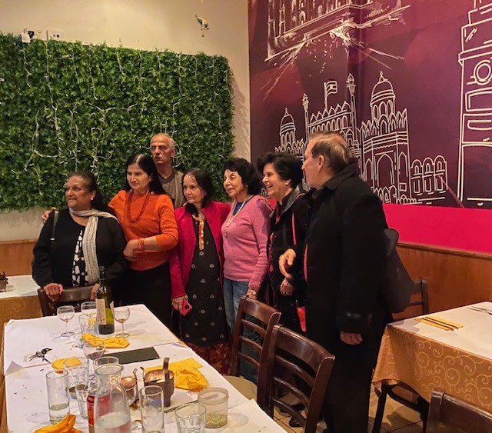
NSW: Australian Indian Medical Gradutaes Association partnership

Slide 43
EVALUATION
Contributing to knowledge and understanding through project evaluation
From audience surveys we have found that:
95% of audience members increased or deepened their understanding of family violence
97% feel it is very important for the community to speak about gender equality
100% feel it is very important for the community to speak up against all forms of family violence – and not sweep things under the carpet

Slide 44
Messages audience members took from the performance
‘Speaking up for yourself but also for others is important’
‘The interrelationship between racism, violence, culture, family, social pressures and gender’
‘Don’t stand by when you see domestic violence.’
‘Family Violence can take many forms and is a social issue we need to address, whether for ourselves or someone else in the community.'

Slide 45
What did the audience members say?
‘Thank you very much for raising awareness and having conversations on violence particularly towards women. Hopefully this will get people in general to self reflect and look for ways to improve their selves and be a better example for family and community.’
‘It is an incredible initiative to create awareness.’
‘This is a great initiative. Many many more are needed to even make a dent in the societal mindsets and prejudices.’

Slide 46
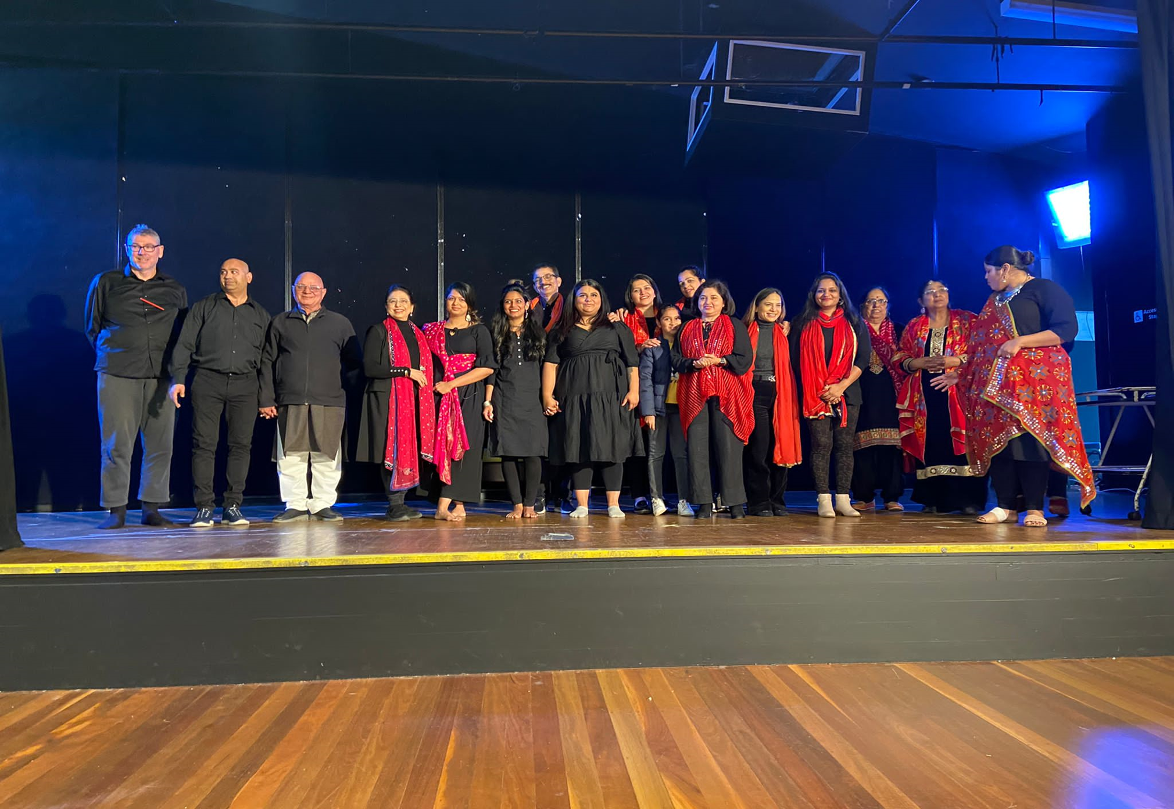
THANK YOU
FOR LISTENING

