Slide 1




AGM
ANNUAL REPORT
2023

Slide 2
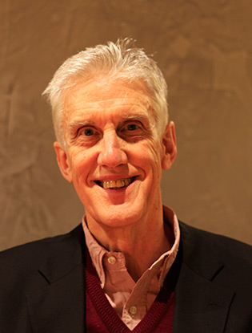


CHAIRMAN’S REPORT
PROFESSOR IAN HOWIE

Slide 3

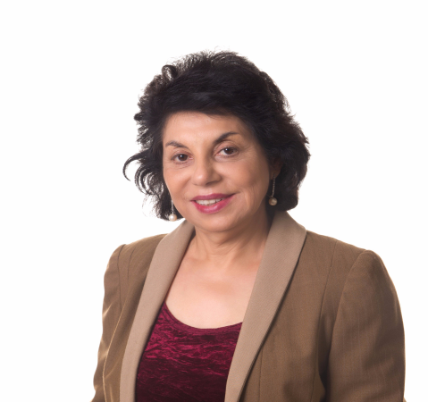
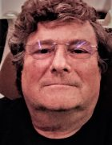
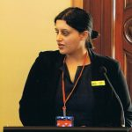
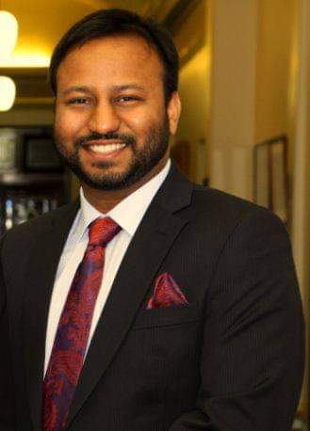
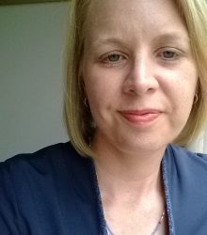
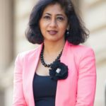
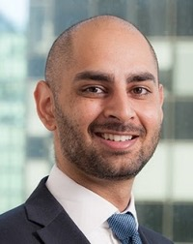
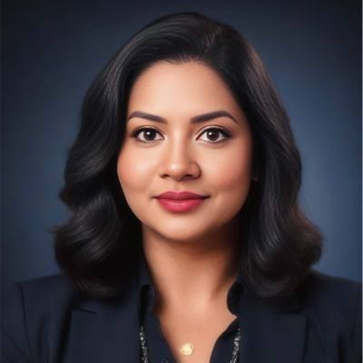
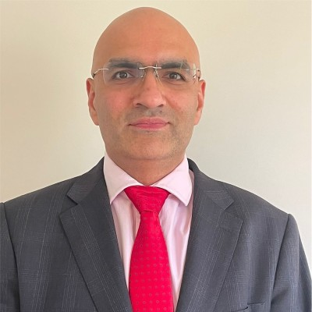
ACHRH BOARD 2023-2025

Slide 4

Audited Income and Expense Statement
For the year ended 30 June 2022

Slide 5
Accounts are unaudited, will be completed by February 2024.
Thanks to book keepr Ms Nyein Nyein for preparing the financial statement

Slide 6
INCOME
2022 | 2023
Grants 167,974 | Grants 111,924
Donations 21,380 | Donations 1,295
189,354 | 113,219

Slide 7
Expenditure
2022 | 2023
84,727 | 72,734
Surplus 104,627 | Surplus 40,485

Slide 8
Assets and Liabilities Statement
2022-2023 Total Assets - 343,847,37
2021-22 Chq Account – 228561 Term deposit -51383 Donation – 21126 GST Refund -4220 Total Assets -305,290.00 Total Liabilities Rent Payable -0.00 other liabilities-0.00 Total Liabilities – 0.,00 305,290.00 ----------------------------------------------------- Retained earnings-200.662.00 Current earnings- 104,627.00 Total Assets- 305.289.00
Current Assets
    Cheque account -263,936.37
    Term Deposit – 52,589.98
    Donation Account -27.321.02
  Total Assets - 343,847.37
  -----------------------------------------------------------------------------------------------------------------------------------------------------------------------------------------
  Total Liabilities
    Rent Payable -0.00
    other liabilities-0.00
    Total Liabilities – 0.,00
  -
  -----------------------------------------------------------------------------------------------------------------------------------------------------------------------------------------------------------------------------------------------------------------------------
  Total Assets – 343,847.37
  --------------------------------------------------------------------------------------------------------------------------------------------------------------------------------------------------------------------
  Member benefits
  Retained earning –303,362.37
  Current earning – 40,485
  Total 343,847.37

Slide 9
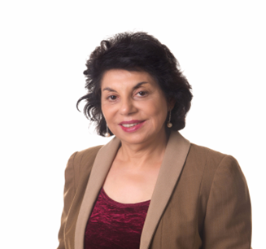
EXECUTIVE DIRECTOR ‘S REPORT
PROFESSOR MANJULA
DATTA O’CONNOR

Slide 10
ACHRH influence on policy
Dowry Abuse campaign initiated in 2012 with a petition signed b y 600 community members to include dowry abuse in the Vic FV Protection Act
Dowry abuse recognized in the Victorian FV Prevention Act 2019 , and in WA Legislation
NSW MP presented an Independent Members Bill requesting dowry abuse inclusion in NSW Coercive Control legislation in 2023
ACHRH Invited by the Federal AG to round table discussion on coercive control legislation in 2022.
2023 Attorney General National Paper on Coercive Control includes Dowry Abuse as an exemple of economical coercion
Dowry abuse recognized as a form of domestic abuse in National Plans to prevent domestic violence 2012-2022, 2023-2033

Slide 11
Achrh chairs the National dowry abuse working group
.Membership- Good Shepperd , Intouch Multicultural centre, Harmony Alliance and UNSW
The group TOR include- highlight the nature and impact of dowry abuse , prevention of dowry abuse, encourage research in dowry abuse , highlight Gaps in national and state-based data collection
advocating for legislative changes to include dowry abuse at Federal level and States.
Regular meetings are held with relevant Govt authorities and Attorneys General .

Slide 12
ACHRH –Advisory and collaboration
ACHRH is member of the National Advocacy Group to advocate for victims of family violence on TEMPORARY VISAS
The membership of the group consists of a larger general group comprising about 50 national members –core DV service providers , researchers and NGO s
And a smaller Executive group. ACHRH is a member of both groups
The Group has had a significant impact on the policy

Slide 13


Slide 14


Slide 15


Slide 16
Advocacy and Results
Minister Andrew Giles
Minister Clare O’Neil
Minister Ros Spence
All states members are advocating to their key bodies
RESULT
Temp visa victims no longer deported immediately
They stay and fight their family property cases
If they had partner visa application n and sponsorship withdrawn that application is considered valid, and they get their permanent residency
Medicare support immediately
Legal Aid support
Housing support
$5000 CASH support

Slide 17
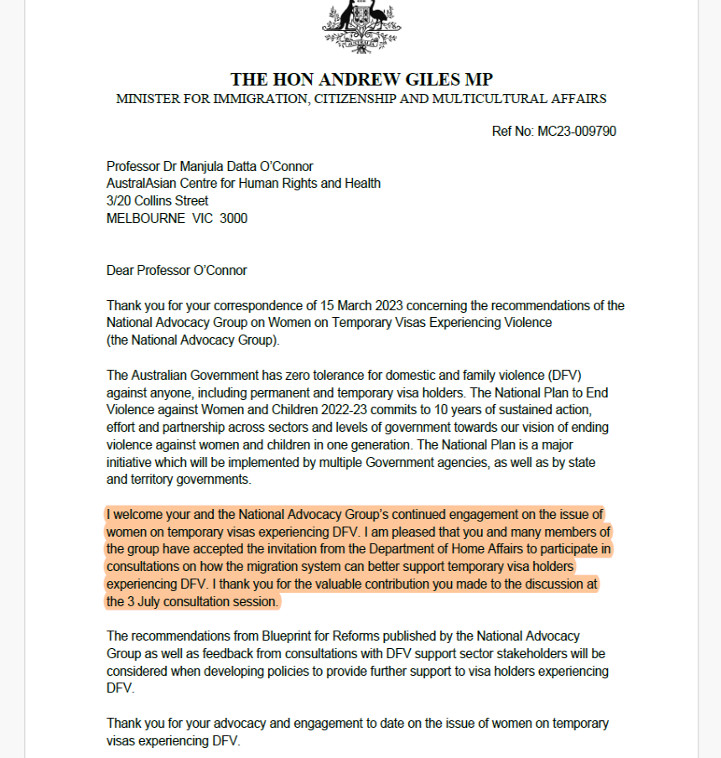

Slide 18
Project Work 2022
Mutual Relational Respect workshops since 2012
National dowry abuse prevention education campaign 2020-2022
Sneh community participatory theatre project. 2021-2024
Three-monthly ACHRH Newsletter

Slide 19
Mutual Relational Respect workshops since 2012
The migration experience involves a complex combination of losses and opportunities. The migrants leave their homeland, family and friends, traditions and culture.
Migrants arriving in Australia can be isolated, disengaged, making them vulnerable to domestic violence, and related mental health issues . Yet there are few opportunities for migrants to learn about the new cultural system they are entering, or more particularly explore deeper understanding of social norms and notions of gender equality.
ACHRH has identified and been working to address this gap for about a decade. In 2013, ACHRH implemented the Mutual Cultural Respect training project
it won the Victorian Govt Multicultural Award for Excellence award for COMMUNITY INNOVATION
Suitable for new migrants

Slide 20





Slide 21
2017-2024 ACHRH awarded DSS funding to extend MCR training to primary prevention :
MRR project was conceptualized
How- The MRR project explores how women and men use their local cultural references to make sense of domestic violence they have experienced or witnessed. It uses adult learning principles respecting and builds on the knowledge and life experiences of adult participants in interactive workshops
What - The workshops address primary prevention of violence against women through providing opportunities to discuss health relationships and lifestyles, shared decision-making, enhanced harmony and equality, and championing the fight against family violence.
Funding 2017– to continue into 2024
Suitable for Professionals , University/TAFE students , and adults

Slide 22
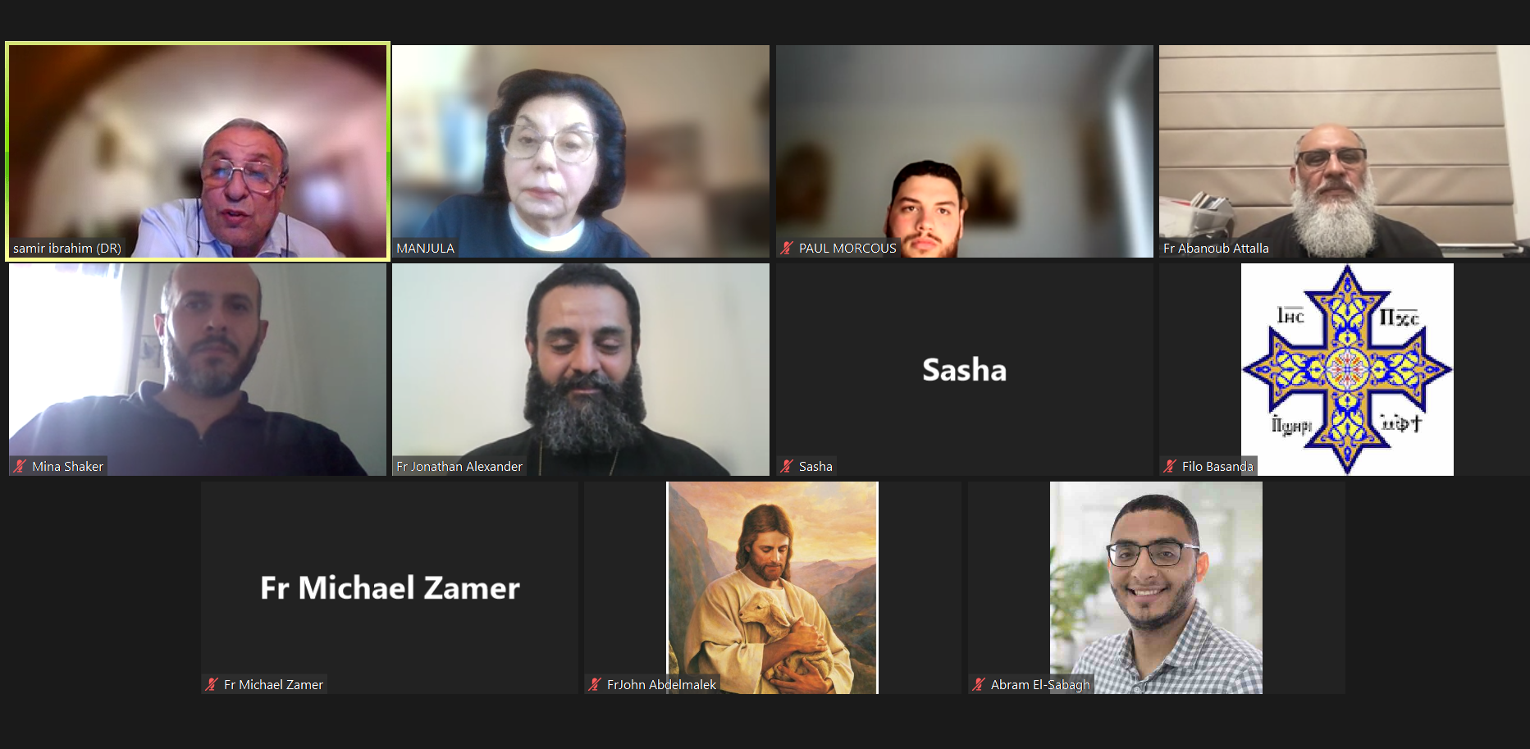
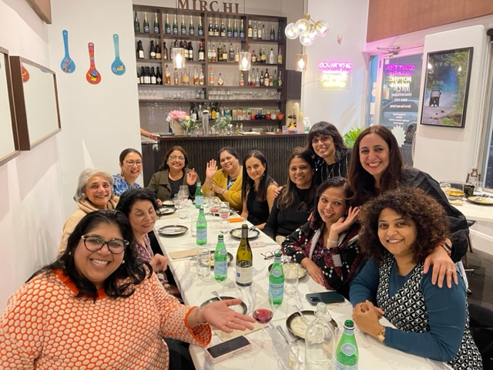
MRR with Professionals
Lady Doctors group Egyptian Trainee Priests

Slide 23
Feedback
From the Priests group
thank you for the opportunity and the great understanding of such a touchy subject which is often seen during our dealing with the public, and did not know a lot of what was said. Thank you .
Great opportunity ……………definitely help us to understand more the dynamics of the family and have a better and more sensible and scientific approach to serving families.
From the Lady Doctors Group
Really appreciate ….. Help our intimate partner violence victims Dr P
Thank you everyone for a wonderful evening with some valuable insightful discussions and lots of fun.
Fun filled meeting tonight with some serious discussions and opinions .

Slide 24

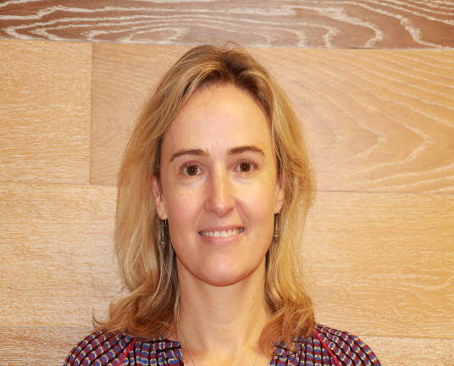

ACHRH NEWSLETTER
Thank you Gauri Kapoor and Kristin Aitken !
3 -4 newsletters produced annually

Slide 25
Evaluation of programs by
Effective Change
Clare Keating

Slide 26
Dowry Abuse prevention campaign
A grant over three years with Harmony Alliance started in 2020-2022
Project Aims:
Engage and upskill migrant and refugee community leaders to raise awareness of dowry abuse in their communities, counter attitudes that condone violence and increase the ability of community members to address and prevent dowry abuse within their relationships, families, and communities.
To achieve this, the project adopted an intersectional community-led, co-design approach, alongside a culturally tailored, trauma-informed and intersectional method.
In being intersectional, the project acknowledged the diversity of experiences of people from migrant and refugee backgrounds with awareness of the intersecting impacts of gender for women

Slide 27
National Dowry Abuse Prevention Project Outputs
Ran national surveys targetted at:
  the South Asian community around the prevalence of dowry abuse in Australia
  Service providers
Conducted five national online focus groups with South Asian community members
Prepared national workshops titled: “Demand Equality, Not Dowry”
Trained 15 trainers nationally to run the workshops
36 “Demand Equality, Not Dowry” workshops were conducted nationally
Ran a focus group with trainers to reflect on the project outcomes
Produced an academic paper on “Heath Impacts of Dowry Abuse” published 2022 in MJA
Produced a report analysing the themes raised in the focus groups
Grant extended into 2023 -24 to scale up the output to reach thousands

Slide 28
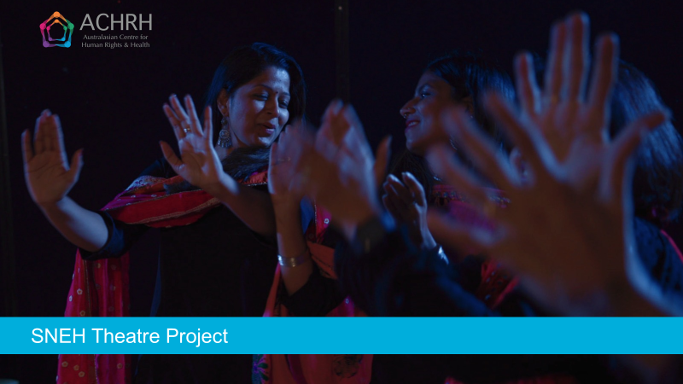
FLAGSHIP PROJECT 2022

Slide 29
About the grant program
The objectives of the Supporting Multicultural and Faith Communities to Prevent Family Violence 2021 Program are to:
deepen and expand primary prevention and early intervention activity with multicultural and faith communities
continue to build and enhance the collective knowledge of successful primary prevention and early intervention activity and intersectional practice
strengthen the capacity of organisations working with multicultural and faith communities in primary prevention and early intervention activity
improve the identification and response to victim survivors of violence by better joining primary prevention activity with early intervention activity in a wide range of settings.

Slide 30
Supporting Multicultural and Faith Communities to Prevent Family Violence
The Sneh Theatre Project was funded through the Supporting Multicultural and Faith Communities to Prevent Family Violence: 2021 Grant Program under the DFFH
The Program will contribute to the Victorian Government’s vision to create a Victoria free from violence
The program uses Change the Story: A Shared Framework as the knowledge base to guide the scope of prevention activity

Slide 31


SNEH Theatre Project
in partnership with the Oorja Foundation
Film director and photography: Emma Macey-Storch
Evaluation:
Approved by the Melbourne Clinic Research Ethics Committee
Funded by the Victorian Department of Families, Fairness and Housing under the ‘Supporting Multicultural and Faith Communities to Prevent Family Violence’ Grant Program

Slide 32
Why Community Participatory Theatre?
Based on Forum Theatre, perfected by Augusto Boal (Boal, 1979)
This approach uses CULTURE AS STRENGTH
Working with community and society it is crucial to improve strategies to address issues of social health, moving the locus of control from external agencies to the people who are directly experiencing it.
By bringing the stories of marginalised people on stage, theatre offers a rare opportunity to people on the fringe to be in the centre where, being the experts of their own lives, they can be engaged in a dialogue with the audience to discover and explore collectively how to deal with their own problems.

Slide 33
WHY COMMUNITY PARTCIPATORY THEATRE ?
Baesd on Forum Theatre invented by perfected by Augusto Boal(Boal, 1979).
USING CULTURE AS STRENGTH
Working with community and society it is crucial to improve strategies to address issues of social health, moving the locus of control from external agencies to the people who are directly experiencing it.
Theatre by bringing the stories of marginalized people on stage offers a rare opportunity to people on the fringe to be in the center where, being the experts of their own lives, they can be engaged in a dialogue with the audience to discover and explore collectively how to deal with their own problems.

Slide 34
CP Theatre gives the audience a part in the dramatic action
The community of participants creates and acts out a symbolic representation in which they witness their struggle and highlight the forms of oppressive conflicts within society.
The scenario runs once and is subsequently enacted again, encouraging the audience to stop the action and change the dramatic action replacing a character on the stage.
Discussion is promoted by the facilitator, with the aim to create a deeper understanding of the scenario and gain a critical awareness about cultural assumptions, beliefs and values. And acting ut potentially helpful alternatives

Slide 35
Creating the foundation of Sneh Theatre
The project first researched and explored the community’s understandings around gender norms, gender equality, and family and domestic violence
Two focus groups were conducted with community members
26 Indian community members participated
Key issues identified by the community included:
    Dowry abuse
    Family dynamics
    Migration issues and vulnerabilities
    Impacts of not seeking help
    Gendered drivers of violence

Slide 36
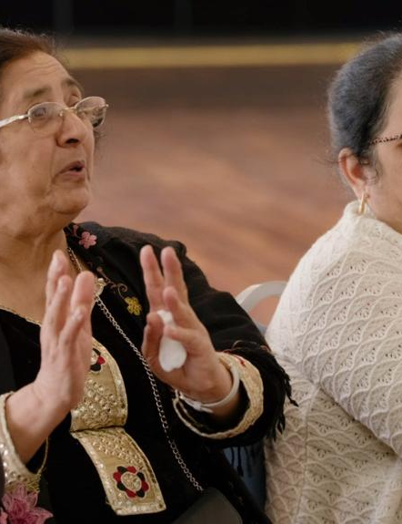
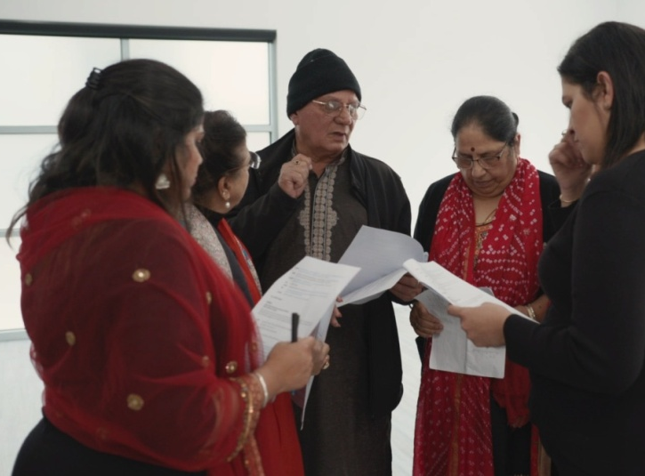
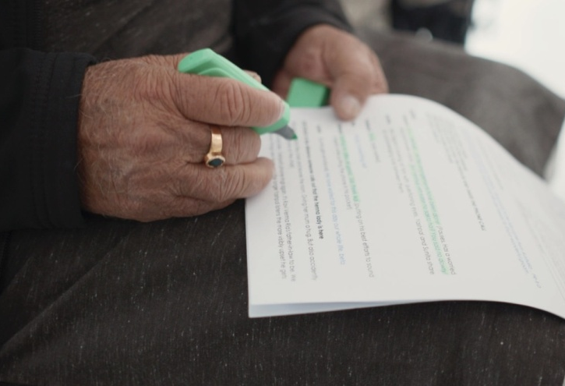
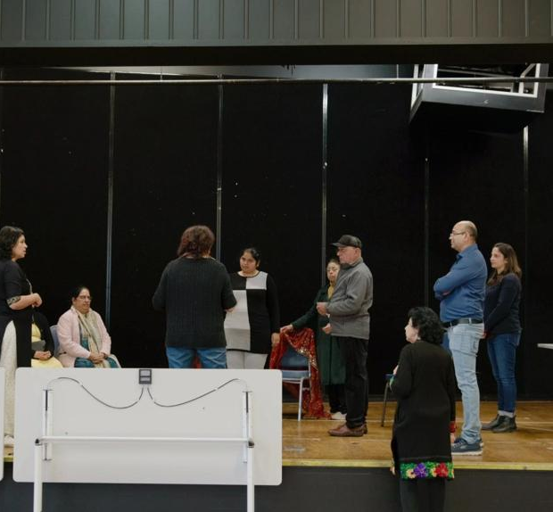
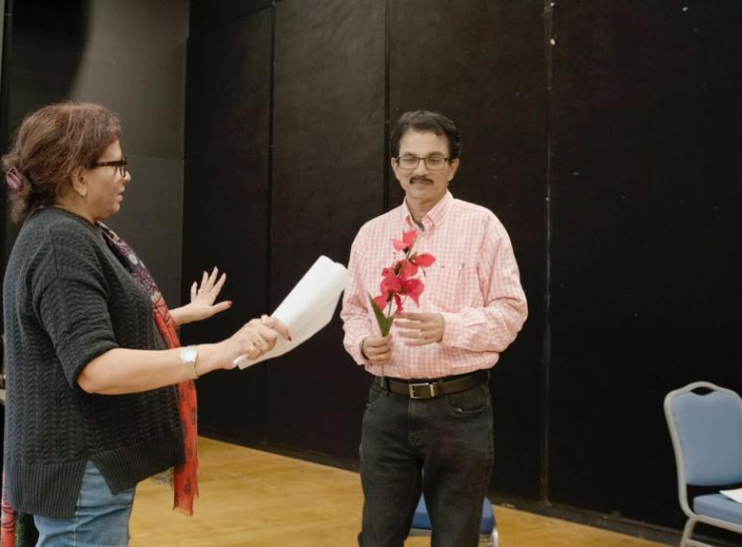
Development and rehearsals
16 volunteer members of the Indian community, together with members of the project team explore themes related to FDV, gender norms, stereotypes and help-seeking
Workshops and rehearsals were run over months, both face to face and online
The workshops dived deep into the themes around early intervention and primary prevention
The purpose of the workshops was to build a trusting theatre ensemble from volunteer participants

Slide 37
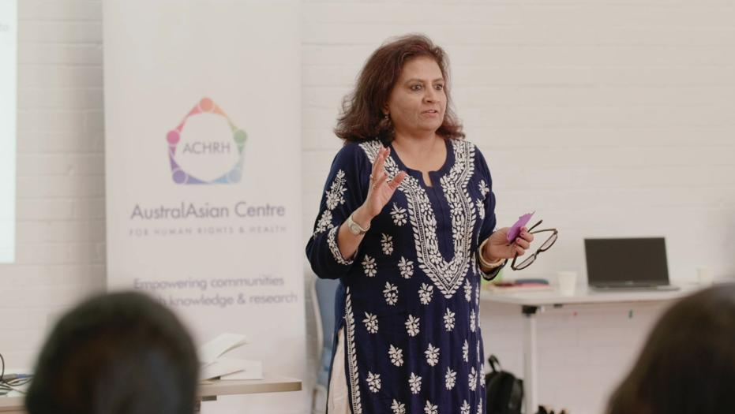
Led by the Theatre Director, and cultural consultants, the group developed and created working scenarios from community and participants’ stories

Slide 38
Three skits were selected for development
Dowry abuse
Migration pressures
Financial pressures that may increase the risk of family violence and the impacts on women and children
Benefits of early help-seeking is a key unifying scheme

Slide 39
Development and rehearsals
16 volunteer members of the Indian community, together with members of the project team explore themes related to FDV , gender norms, stereotypes and help-seeking
Workshops and rehearsals were run over months, both face to face and online
The workshops dived deep into the themes around early intervention and primary prevention

Slide 40
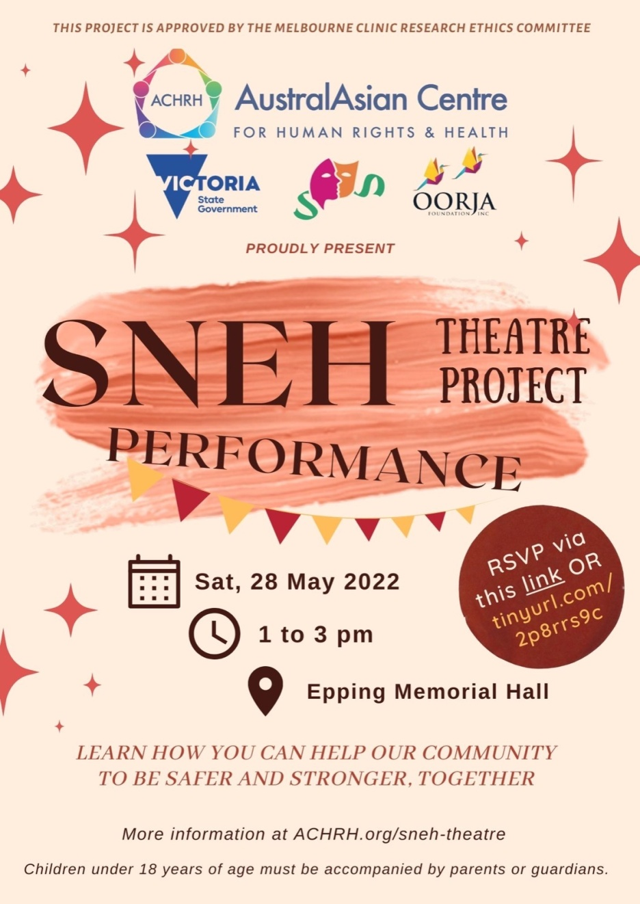
3 Community performances 2022
May 2022: Epping Memorial Hall
Aug 2022: University of New South Wales (UNSW) Sydney
Nov 2022: ISKCON, Albert Park

Slide 41
Community performances - 2023
Following three successful performance in 2022, there were
four performances in 2023:
July 2023: Dosa Hut Function Hall, Melbourne
Newbury Community Centre, Craigieburn
Aug 2023: Dianella Community Centre, Tarneit
Sept 2023: Gasworks Theatre, Albert Park

Slide 42
Evaluation - SNEH – by the numbers
2 community focus groups, with 26 participants
9 members on the project team
14 – 19 community volunteers participated in 5 community workshops
7 community performances reaching approximately 200 audience members
Countless project meetings!
Continuous filming with embedded film crew

Slide 43
EVALUATION
Contributing to knowledge and understanding through project evaluation
From 130 audience surveys we have found that:
94% of audience members increased or deepened their understanding of family violence
95% feel it is very important for the community to speak about gender equality
98% feel it is very important for the community to speak up against all forms of family violence – and not sweep things under the carpet

Slide 44
What did the audience members say?
‘Thank you very much for raising awareness and having conversations on violence particularly towards women. Hopefully this will get people in general to self reflect and look for ways to improve their selves and be a better example for family and community.’
‘It is an incredible initiative to create awareness.’
‘This is a great initiative. Many many more are needed to even make a dent in the societal mindsets and prejudices.’

Slide 45
Messages audience members took from the performance
‘Speaking up for yourself but also for others is important’
‘The interrelationship between racism, violence, culture, family, social pressures and gender’
‘Don’t stand by when you see domestic violence.’
‘Family Violence can take many forms and is a social issue we need to address, whether for ourselves or someone else in the community.'

Slide 46
From the first workshop…

Slide 47
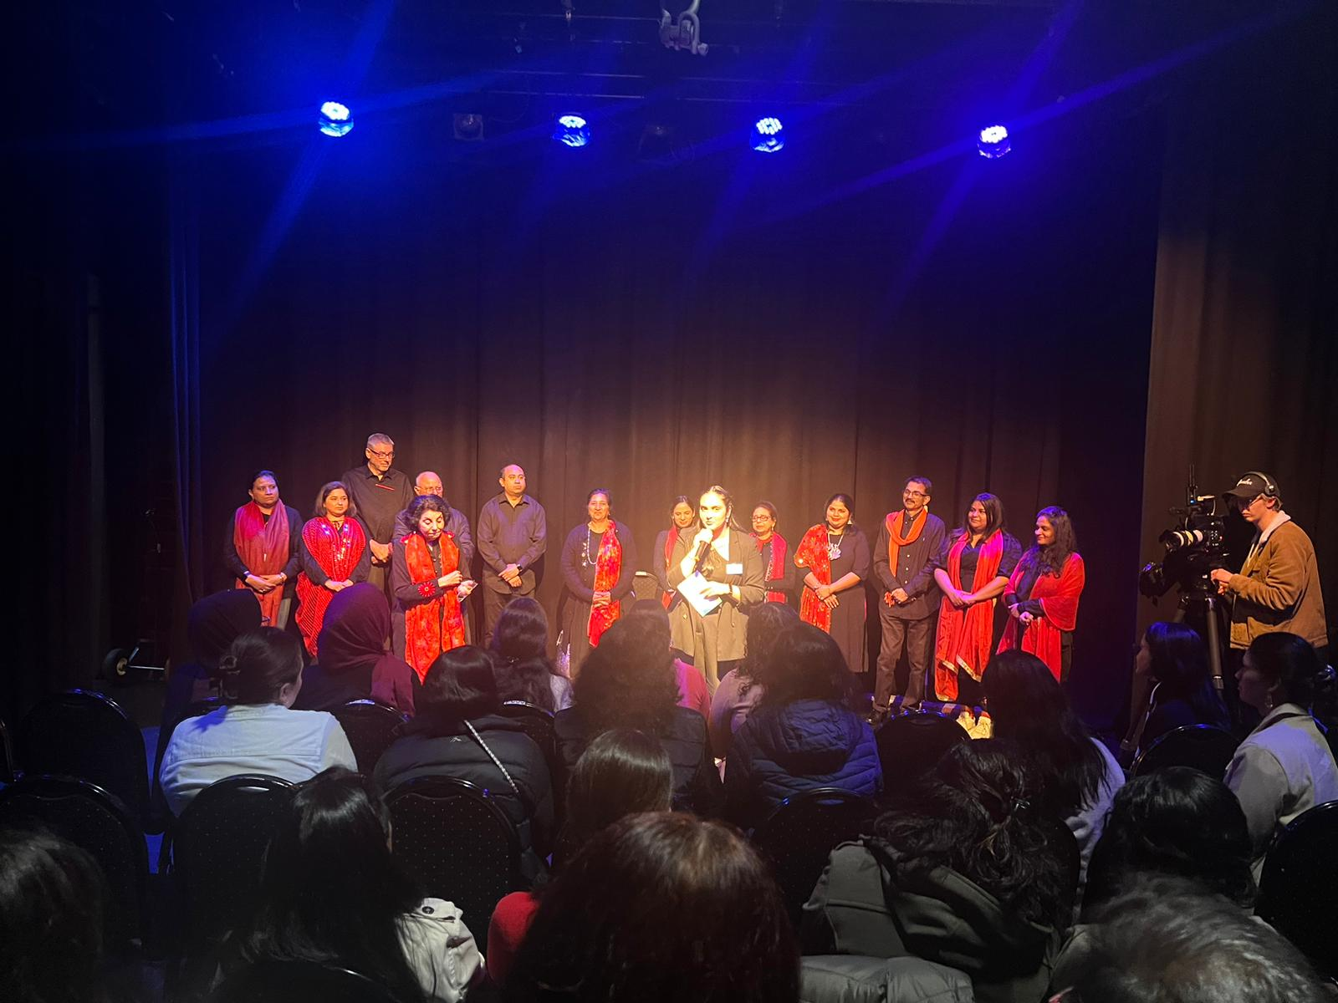
To the final standing ovation

Slide 48
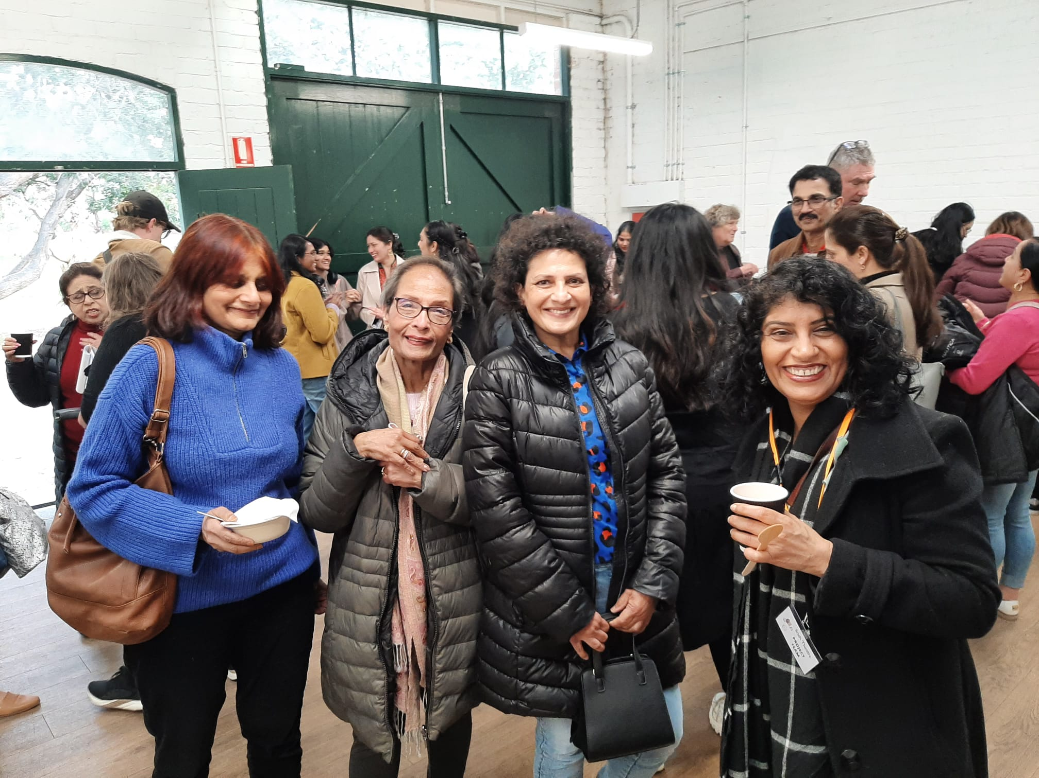
The project brought the community together

Slide 49
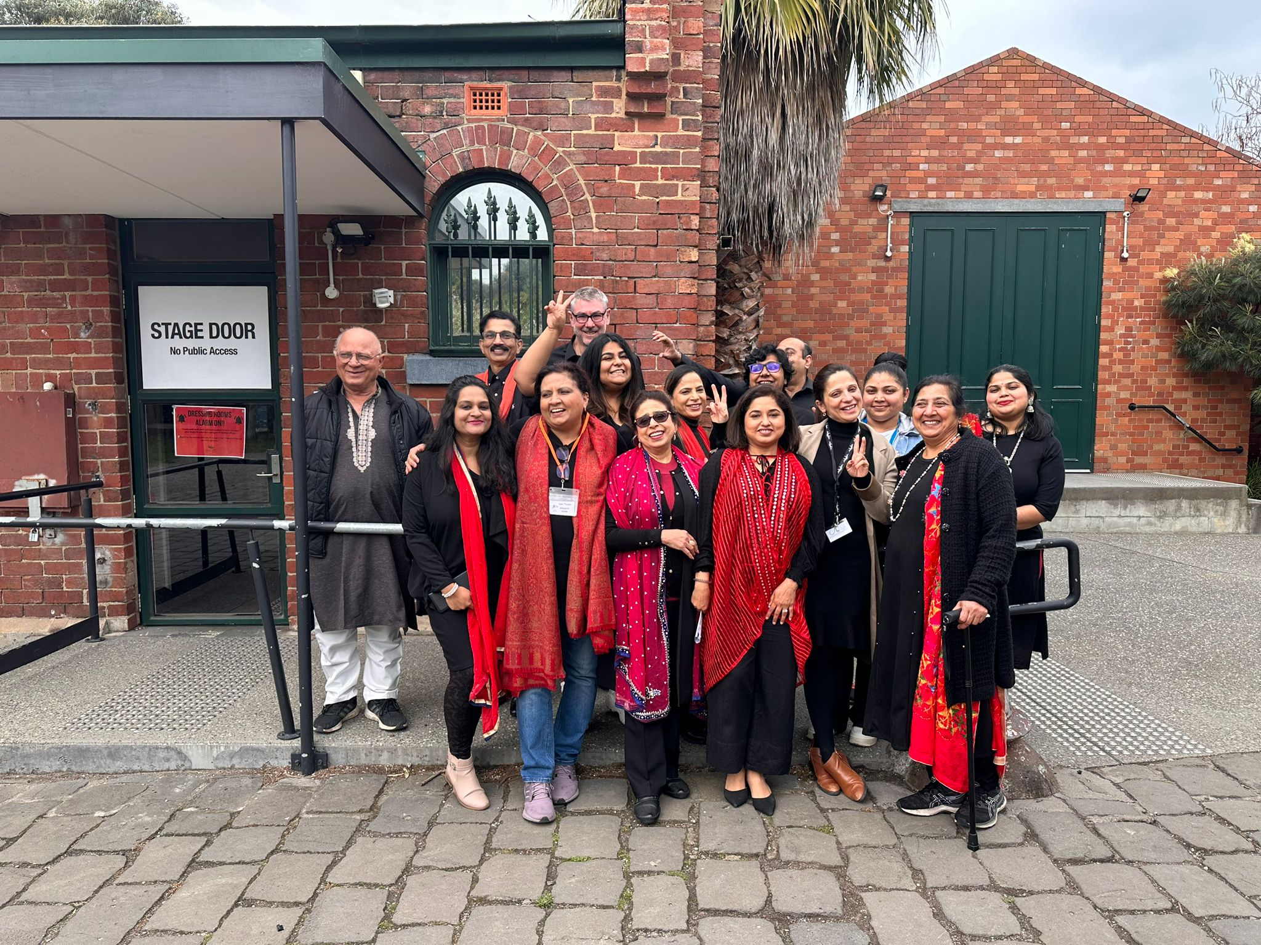
Created an amazing group of actors

Slide 50
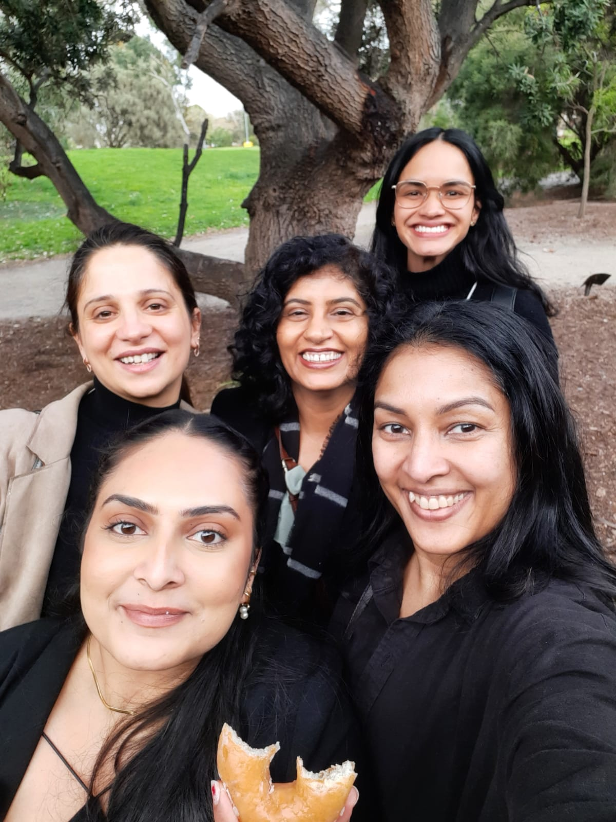
Held together by an amazing Project Team
The team leader managed and coordinated the project team, the theatre cast, the organisation and logistics
Team members contributed to planning, management, communication and promotion, especially through their community and professional networks

Slide 51
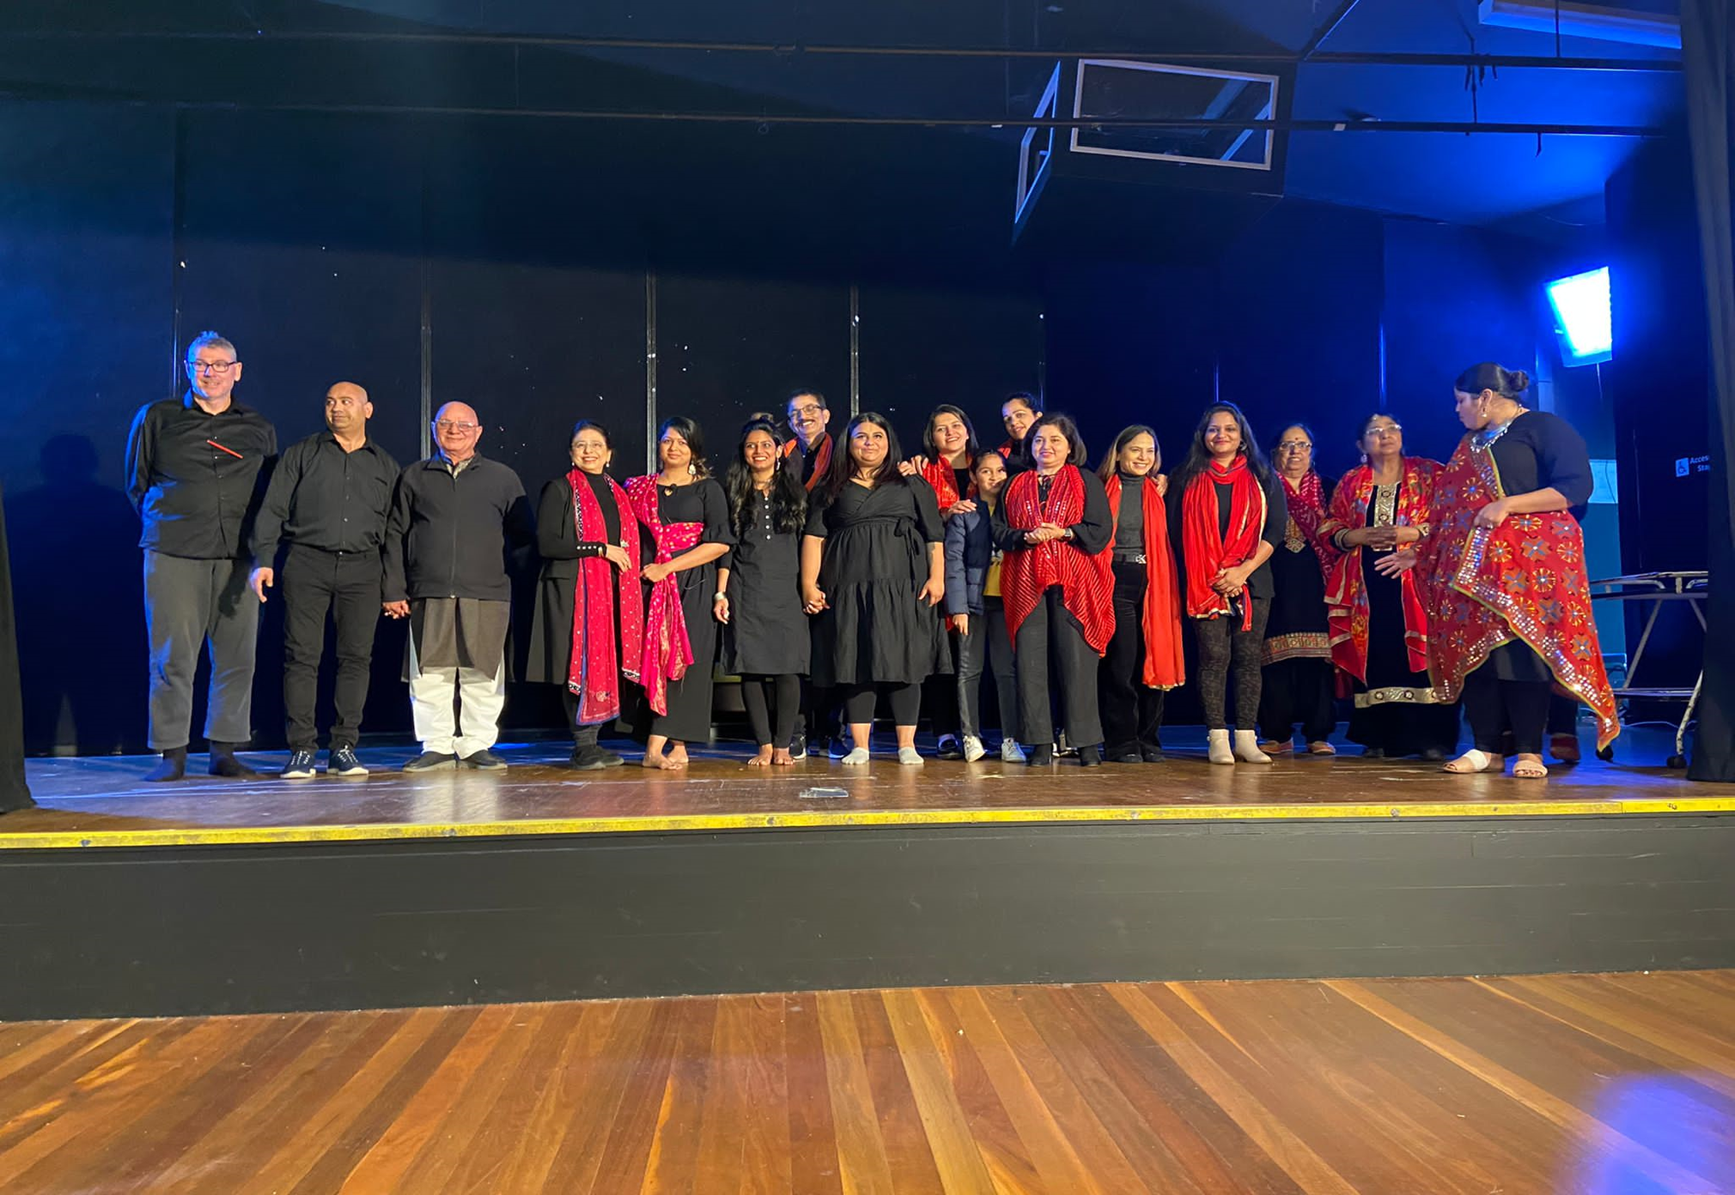
THANK YOU
FOR LISTENING

