Slide 1




AGM ANNUAL REPORT 2024

Slide 2
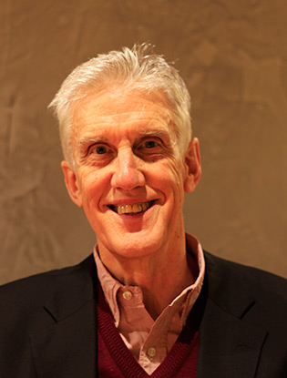


CHAIRMAN’S REPORT PROFESSOR IAN HOWIE

Slide 3

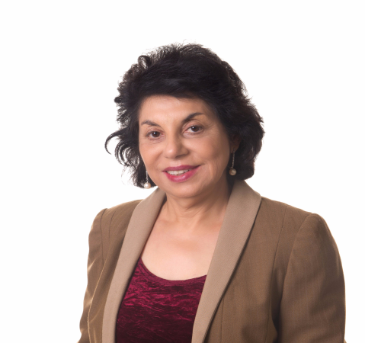
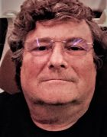
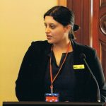
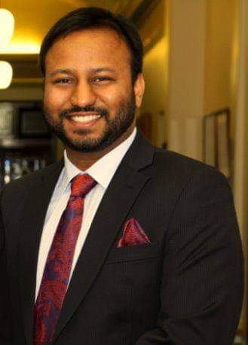
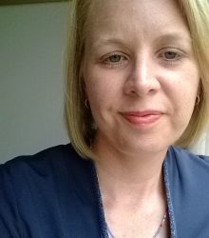
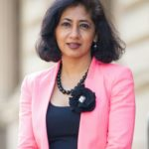
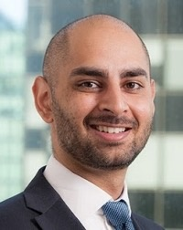
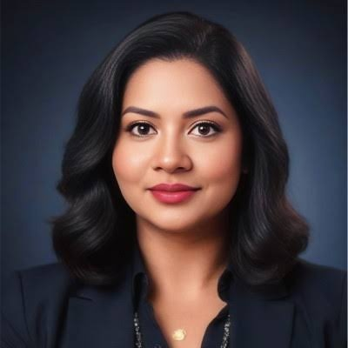
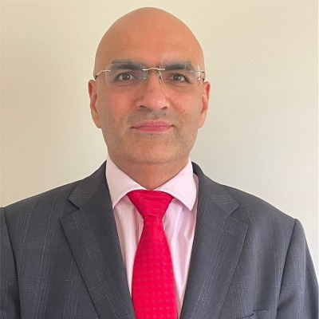
ACHRH BOARD 2023-2025

Slide 4

Audited Income and Expense Statement For the year ended 30 June 2022

Slide 5
Thanks to book keeper Ms Nyein Nyein for preparing the financials for the Year 2023-24

Slide 6
Financial Performance
Key Factors Driving the result in 2023-24
Operating Result in line with prior year (2021-22)
Income
Grants $148.5k
Donations & interest $3.2k
Expenses
SNEH Project $90.7k
MRR Project $8.7k
Dowry Project $5.0k
Other $8.6k

Slide 7
Balance Sheet
 | 2021-22 | 2022-23 | 2023-24
Current Assets | $ | $ | $
Cheque Account | 228,561 | 263,936 | 302,262
Donation Account | 21,126 | 27,321 | 22,116
Term Deposit | 51,383 | 52,590 | 53,963
GST Receivables | 4,220 | 1,929 | 6,203
Current Assets | 305,290 | 345,776 | 384,544
Total Assets | 305,290 | 345,776 | 384,544
Total Labilities | - | - | -
Net Assets | 305,290 | 345,776 | 384,544
Accumulated funds
Retained Earnings | 200,663 | 305,291 | 345,776
Financial Year surplus(loss) | 104627 | 40,485 | 38,768
Total Accumulated funds | 305,290 | 345,776 | 384,544
Key Take away
No Liabilities
Year on Year growth >10%

Slide 8
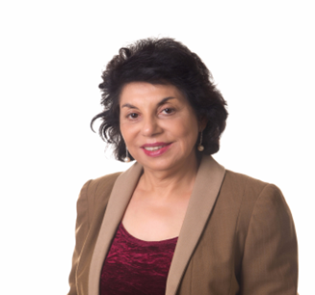
EXECUTIVE DIRECTOR ‘S REPORT PROFESSOR MANJULA DATTA O’CONNOR

Slide 9
Achrh chairs the National dowry abuse working group
.Membership- Good Shepperd , Intouch Multicultural centre, Harmony Alliance and UNSW
The group TOR include- highlight the nature and impact of dowry abuse , prevention of dowry abuse, encourage research in dowry abuse , highlight Gaps in national and state-based data collection
advocating for legislative changes to include dowry abuse at Federal level and States.
Regular meetings are held with relevant Govt authorities and Attorneys General .

Slide 10
ACHRH influence on dowry abuse policy
Dowry Abuse campaign initiated in 2012 with a petition signed b y 600 community members to include dowry abuse in the Vic FV Protection Act
Dowry abuse recognized in the Victorian FV Prevention Act 2019 , and in WA Legislation
NSW MP presented an Independent Members Bill requesting dowry abuse inclusion in NSW Coercive Control legislation in 2023
ACHRH Invited by the Federal AG to round table discussion on coercive control legislation in 2022.
2023 Attorney General National Paper on Coercive Control includes Dowry Abuse as an exemple of economical coercion
Dowry abuse recognized as a form of domestic abuse in National Plans to prevent domestic violence 2012-2022, 2023-2033
August 2024- Federal Family Law Amendment Bill includes dowry absue under Economic abuse, passed by the Senate November 2024 . It will receive Royal Assent in early 2025.

Slide 11
ACHRH –Advisory and collaboration
ACHRH is member of the National Advocacy Group to advocate for victims of family violence on TEMPORARY VISAS
The membership of the group consists of a larger general group comprising about 50 national members –core DV service providers , researchers and NGO s
And a smaller Executive group. ACHRH is a member of both groups
The Group has had a significant impact on the policy

Slide 12
Introduction of economic or financial abuse (including dowry abuse) as family violence
Item 2 of Schedule 1 amends subsection 4AB(2) of the Family Law Act to include ‘economic
or financial abuse’ as an example of behaviour that may constitute family violence.
Proposed subsection 4AB(2A) (at item 3 of Schedule 1) provides detailed examples of
behaviour that may constitute economic or financial abuse. Such behaviour could include:
1.unreasonably denying a family member financial autonomy (including by controlling
superannuation, or sabotaging employment potential);
2. unreasonably withholding financial support required for reasonable living expenses (including the consistent withholding of child support payments);
3. coercing a person to give or seek money as dowry; or hiding or falsely denying things done or agreed to in connection with dowry.

Slide 13
Sch 1 – Property Reforms
Section c )
coercing a family member (including by use of threats, physical abuse
or emotional or psychological abuse):
(i) to give or seek money, assets or other items as dowry;
(ii) to do or agree to things in connection with a practice of dowry;
(d) hiding or falsely denying things done or agreed to by the family member, including hiding or falsely denying the receipt of money, assets or other items, in connection with a practice of dowry

Slide 14


Slide 15
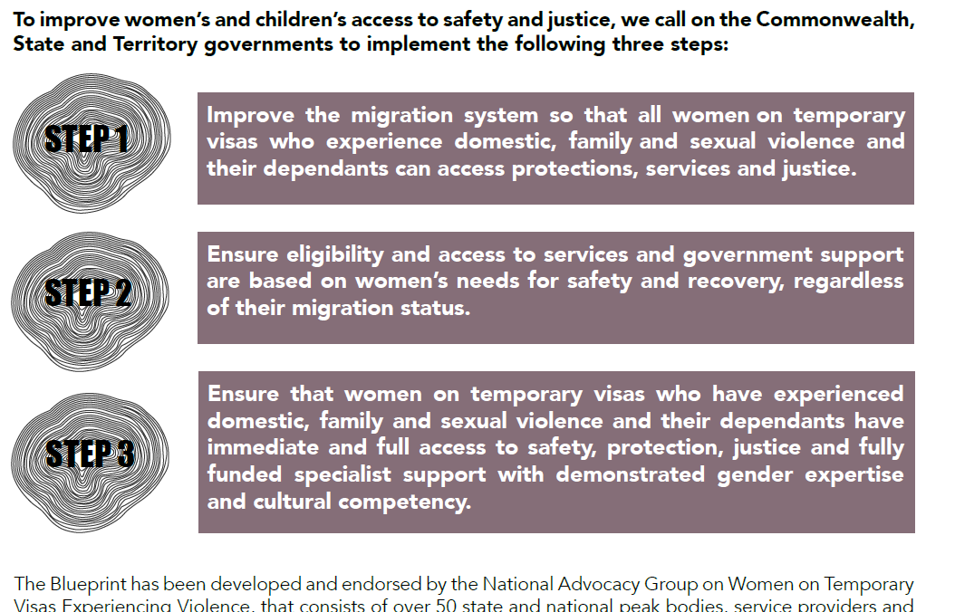

Slide 16
Advocacy and Results
Minister Andrew Giles, Minister Clare O’Neil, Minister Ros Spence
ACHRH is Victorian state Executive Members with Monash Uni And Melbourne Uni , InTouch , Women's Legal service . We regularly meet, plan and advocate
RESULT
Temp visa victims no longer deported immediately
They can stay and fight their family property cases
If they had partner visa application n and sponsorship withdrawn that application is considered valid, and they get their permanent residency
Medicare support immediately
Legal Aid support
Housing support
$5000 CASH support

Slide 17
What is missing-Gaps
International brides or defacto partners whose partner visa application is not in train, and arrived on Temporary visa are not allowed permanent residency visa
They usually end up applying for Protection Visa or International Student Visa ,
or marry someone local with residency visa
We are requesting a special family domestic violence visa to be initiated for such women. The Immigration Department is thinking about it .

Slide 18
Community Educational Projects 2024
Mutual Relational Respect workshops 2020-2024.
45 workshops completed with multicultural groups
Sneh community participatory theatre project. 2021-2023
Film FINDING AFFECTION 2024
Workshops Educational Material using the film theatre skits 2024
Three-monthly ACHRH Newsletter

Slide 19
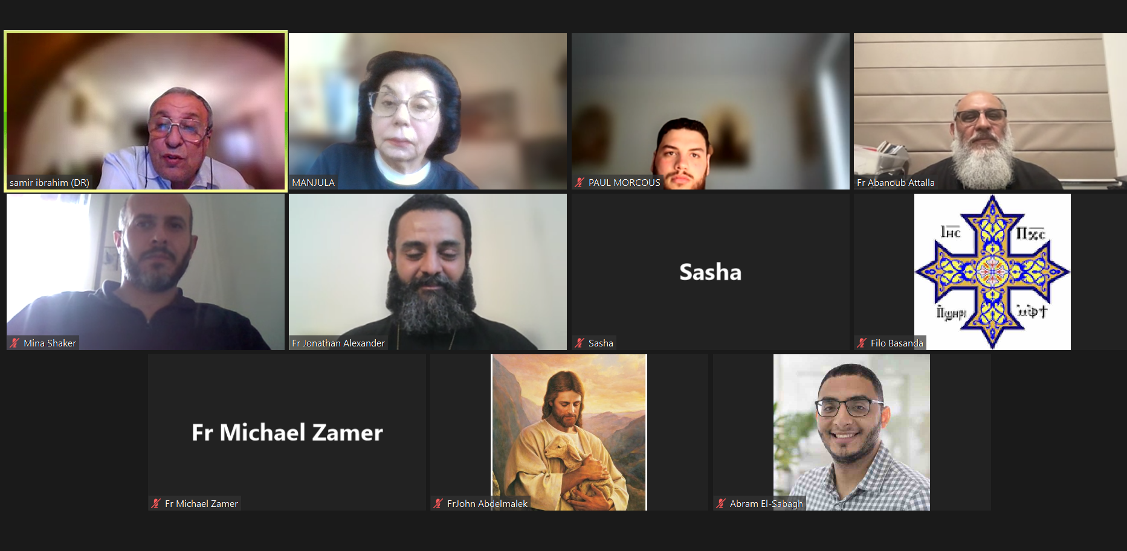
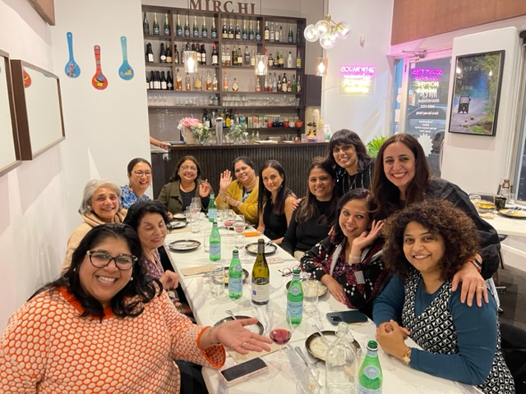
MRR with Professionals Lady Doctors group Egyptian Trainee Priests

Slide 20
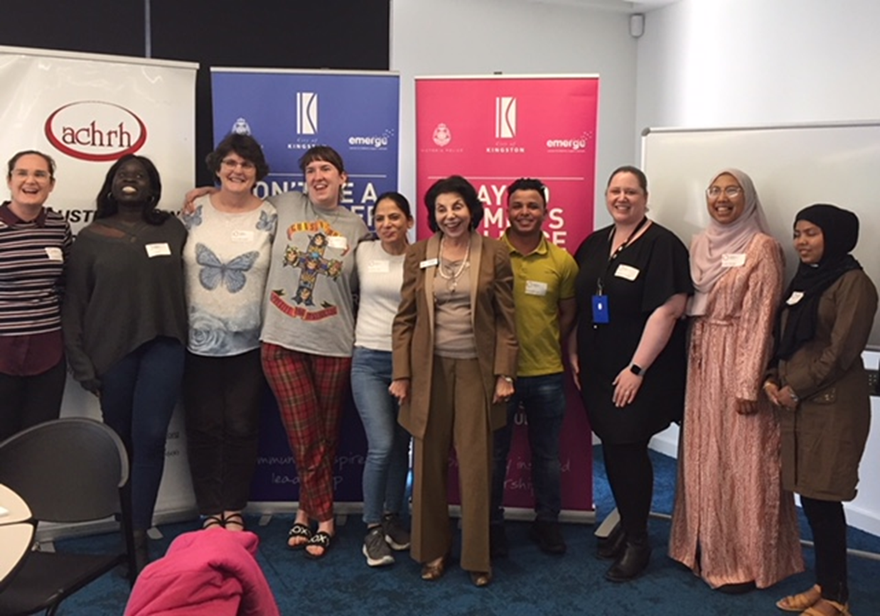

Slide 21
Evaluation
The MRR survey enhanced the knowledge around the following questions from the NCAS
- understanding that non-physical forms of violence are a form of domestic violence
- knowledge of the prevalence of violence against women
- knowledge of resources.
Attitudes to gender inequality improved in the following areas
rigid gender roles, stereotypes and expressions
women’s independence and decision-making in private life: responses to the statement ‘Domestic violence is a private matter to be handled in the family’.
Little change seen in
male peer relations involving aggression and disrespect towards women
women’s independence and decision-making in public life-preferring male political leaders

Slide 22
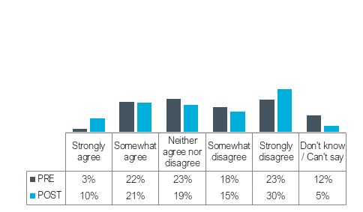
Denying gender inequality is a problem
Participants were asked the extent to which they agreed or disagreed with the statement ‘Many women exaggerate how unequally women are treated in Australia.’ as shown in Figure 12.
After the workshop there was an increase in disagreement after the workshop (from 41% to 45%),
participants who ‘agreed’ with the statement also increased (from 25% to 31%).
The participants who didn’t know or were neutral decreased after the workshop

Slide 23
Feedback
From the Priests group
thank you for the opportunity and the great understanding of such a touchy subject which is often seen during our dealing with the public, and did not know a lot of what was said. Thank you .
Great opportunity ……………definitely help us to understand more the dynamics of the family and have a better and more sensible and scientific approach to serving families.
From the Lady Doctors Group
Really appreciate ….. Help our intimate partner violence victims Dr P
Thank you everyone for a wonderful evening with some valuable insightful discussions and lots of fun.
Fun filled meeting tonight with some serious discussions and opinions .
The doctors agreed that the workshop would influence their ability to understand and deal woth patients suffering FV

Slide 24
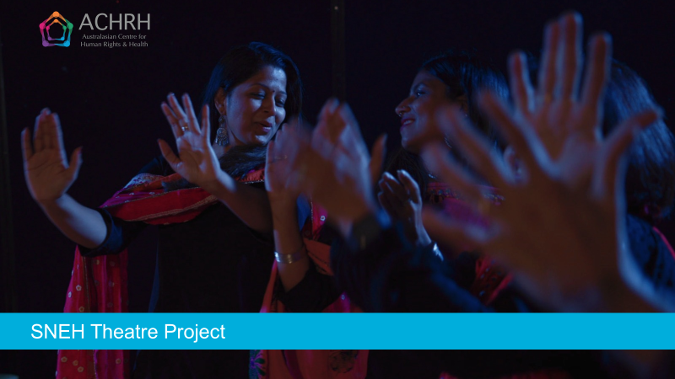
FLAGSHIP PROJECT 2022

Slide 25


SNEH Theatre Project
in partnership with the Oorja Foundation
Film director and photography: Emma Macey-Storch
Evaluation:
Approved by the Melbourne Clinic Research Ethics Committee
Funded by the Victorian Department of Families, Fairness and Housing under the ‘Supporting Multicultural and Faith Communities to Prevent Family Violence’ Grant Program

Slide 26
About the grant program
The objectives of the Supporting Multicultural and Faith Communities to Prevent Family Violence 2021 Program are to:
deepen and expand primary prevention and early intervention activity with multicultural and faith communities
continue to build and enhance the collective knowledge of successful primary prevention and early intervention activity and intersectional practice
strengthen the capacity of organisations working with multicultural and faith communities in primary prevention and early intervention activity
improve the identification and response to victim survivors of violence by better joining primary prevention activity with early intervention activity in a wide range of settings.

Slide 27
Why Community Participatory Theatre?
Based on Forum Theatre, perfected by Augusto Boal (Boal, 1979)
This approach uses CULTURE AS STRENGTH
Working with community and society it is crucial to improve strategies to address issues of social health, moving the locus of control from external agencies to the people who are directly experiencing it.
By bringing the stories of marginalised people on stage, theatre offers a rare opportunity to people on the fringe to be in the centre where, being the experts of their own lives, they can be engaged in a dialogue with the audience to discover and explore collectively how to deal with their own problems.

Slide 28
WHY COMMUNITY PARTCIPATORY THEATRE ?
Baesd on Forum Theatre invented by perfected by Augusto Boal(Boal, 1979).
USING CULTURE AS STRENGTH
Working with community and society it is crucial to improve strategies to address issues of social health, moving the locus of control from external agencies to the people who are directly experiencing it.
Theatre by bringing the stories of marginalized people on stage offers a rare opportunity to people on the fringe to be in the center where, being the experts of their own lives, they can be engaged in a dialogue with the audience to discover and explore collectively how to deal with their own problems.

Slide 29
CP Theatre gives the audience a part in the dramatic action
The community of participants creates and acts out a symbolic representation in which they witness their struggle and highlight the forms of oppressive conflicts within society.
The scenario runs once and is subsequently enacted again, encouraging the audience to stop the action and change the dramatic action replacing a character on the stage.
Discussion is promoted by the facilitator, with the aim to create a deeper understanding of the scenario and gain a critical awareness about cultural assumptions, beliefs and values. And acting ut potentially helpful alternatives

Slide 30
Creating the foundation of Sneh Theatre
The project first researched and explored the community’s understandings around gender norms, gender equality, and family and domestic violence
Two focus groups were conducted with community members
26 Indian community members participated
Key issues identified by the community included:
Dowry abuse
Family dynamics
Migration issues and vulnerabilities
Impacts of not seeking help
Gendered drivers of violence

Slide 31
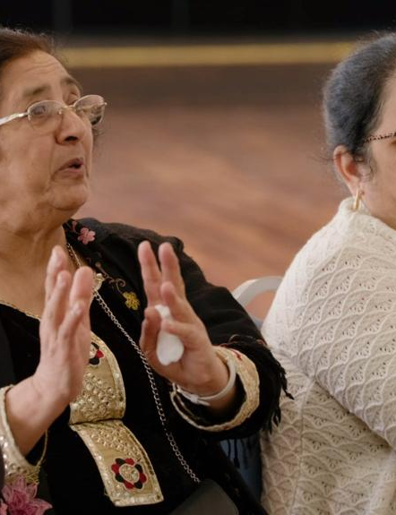
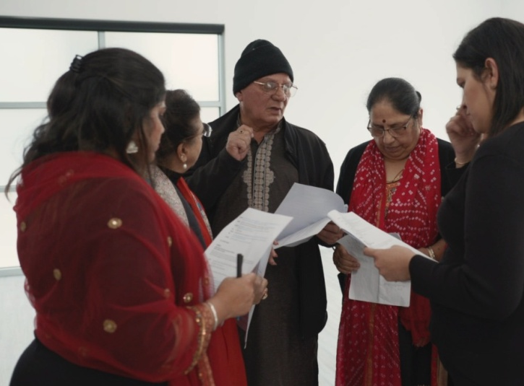
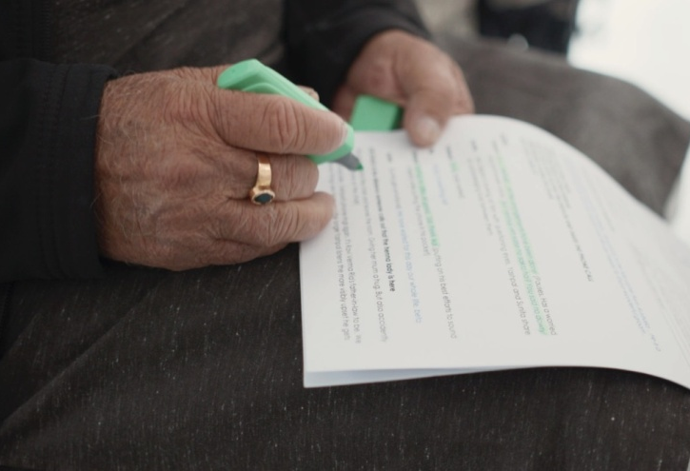
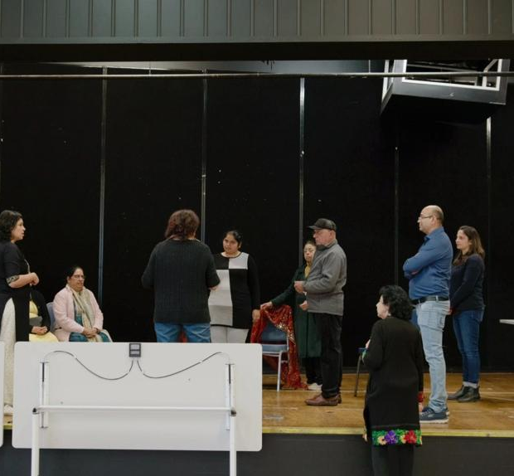
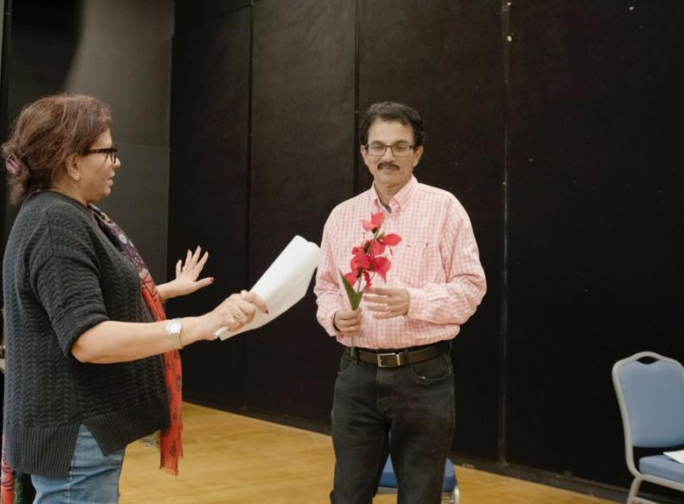
Development and rehearsals
16 volunteer members of the Indian community, together with members of the project team explore themes related to FDV, gender norms, stereotypes and help-seeking
Workshops and rehearsals were run over months, both face to face and online
The workshops dived deep into the themes around early intervention and primary prevention
The purpose of the workshops was to build a trusting theatre ensemble from volunteer participants

Slide 32
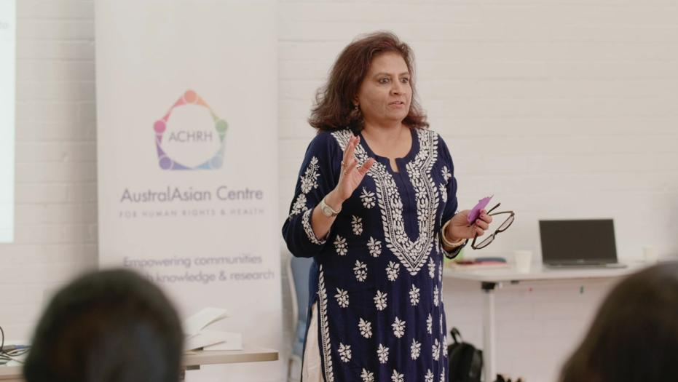
Led by the Theatre Director, and cultural consultants, the group developed and created working scenarios from community and participants’ stories

Slide 33
Three skits were selected for development
Dowry abuse
Migration pressures
Financial pressures that may increase the risk of family violence and the impacts on women and children
Benefits of early help-seeking is a key unifying scheme

Slide 34
Development and rehearsals
16 volunteer members of the Indian community, together with members of the project team explore themes related to FDV , gender norms, stereotypes and help-seeking
Workshops and rehearsals were run over months, both face to face and online
The workshops dived deep into the themes around early intervention and primary prevention

Slide 35
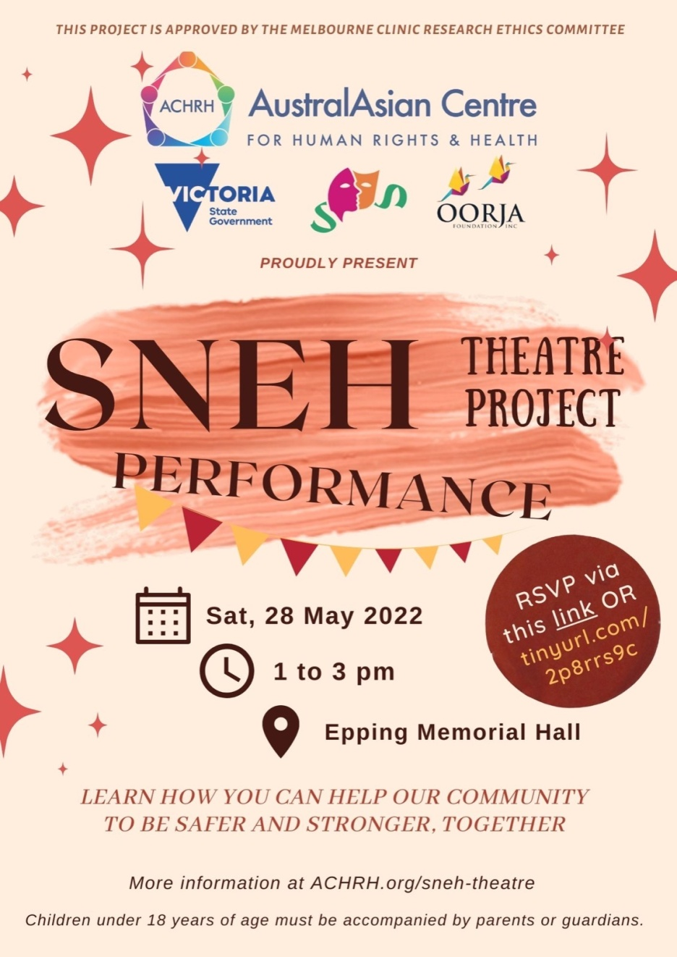
3 Community performances 2022
May 2022: Epping Memorial Hall
Aug 2022: University of New South Wales (UNSW) Sydney
Nov 2022: ISKCON, Albert Park

Slide 36
Community performances - 2023
Following three successful performance in 2022, there were
four performances in 2023:
July 2023: Dosa Hut Function Hall, Melbourne
Newbury Community Centre, Craigieburn
Aug 2023: Dianella Community Centre, Tarneit
Sept 2023: Gasworks Theatre, Albert Park

Slide 37
Evaluation - SNEH – by the numbers
2 community focus groups, with 26 participants
9 members on the project team
14 – 19 community volunteers participated in 5 community workshops
7 community performances reaching approximately 200 audience members
50 project meetings!
Continuous filming with embedded film crew

Slide 38
EVALUATION Contributing to knowledge and understanding through project evaluation
From 130 audience surveys we have found that:
94% of audience members increased or deepened their understanding of family violence
95% feel it is very important for the community to speak about gender equality
98% feel it is very important for the community to speak up against all forms of family violence – and not sweep things under the carpet

Slide 39
What did the audience members say?
‘Thank you very much for raising awareness and having conversations on violence particularly towards women. Hopefully this will get people in general to self reflect and look for ways to improve their selves and be a better example for family and community.’
‘It is an incredible initiative to create awareness.’
‘This is a great initiative. Many many more are needed to even make a dent in the societal mindsets and prejudices.’

Slide 40
Messages audience members took from the performance
‘Speaking up for yourself but also for others is important’
‘The interrelationship between racism, violence, culture, family, social pressures and gender’
‘Don’t stand by when you see domestic violence.’
‘Family Violence can take many forms and is a social issue we need to address, whether for ourselves or someone else in the community.'

Slide 41
From the first workshop…

Slide 42
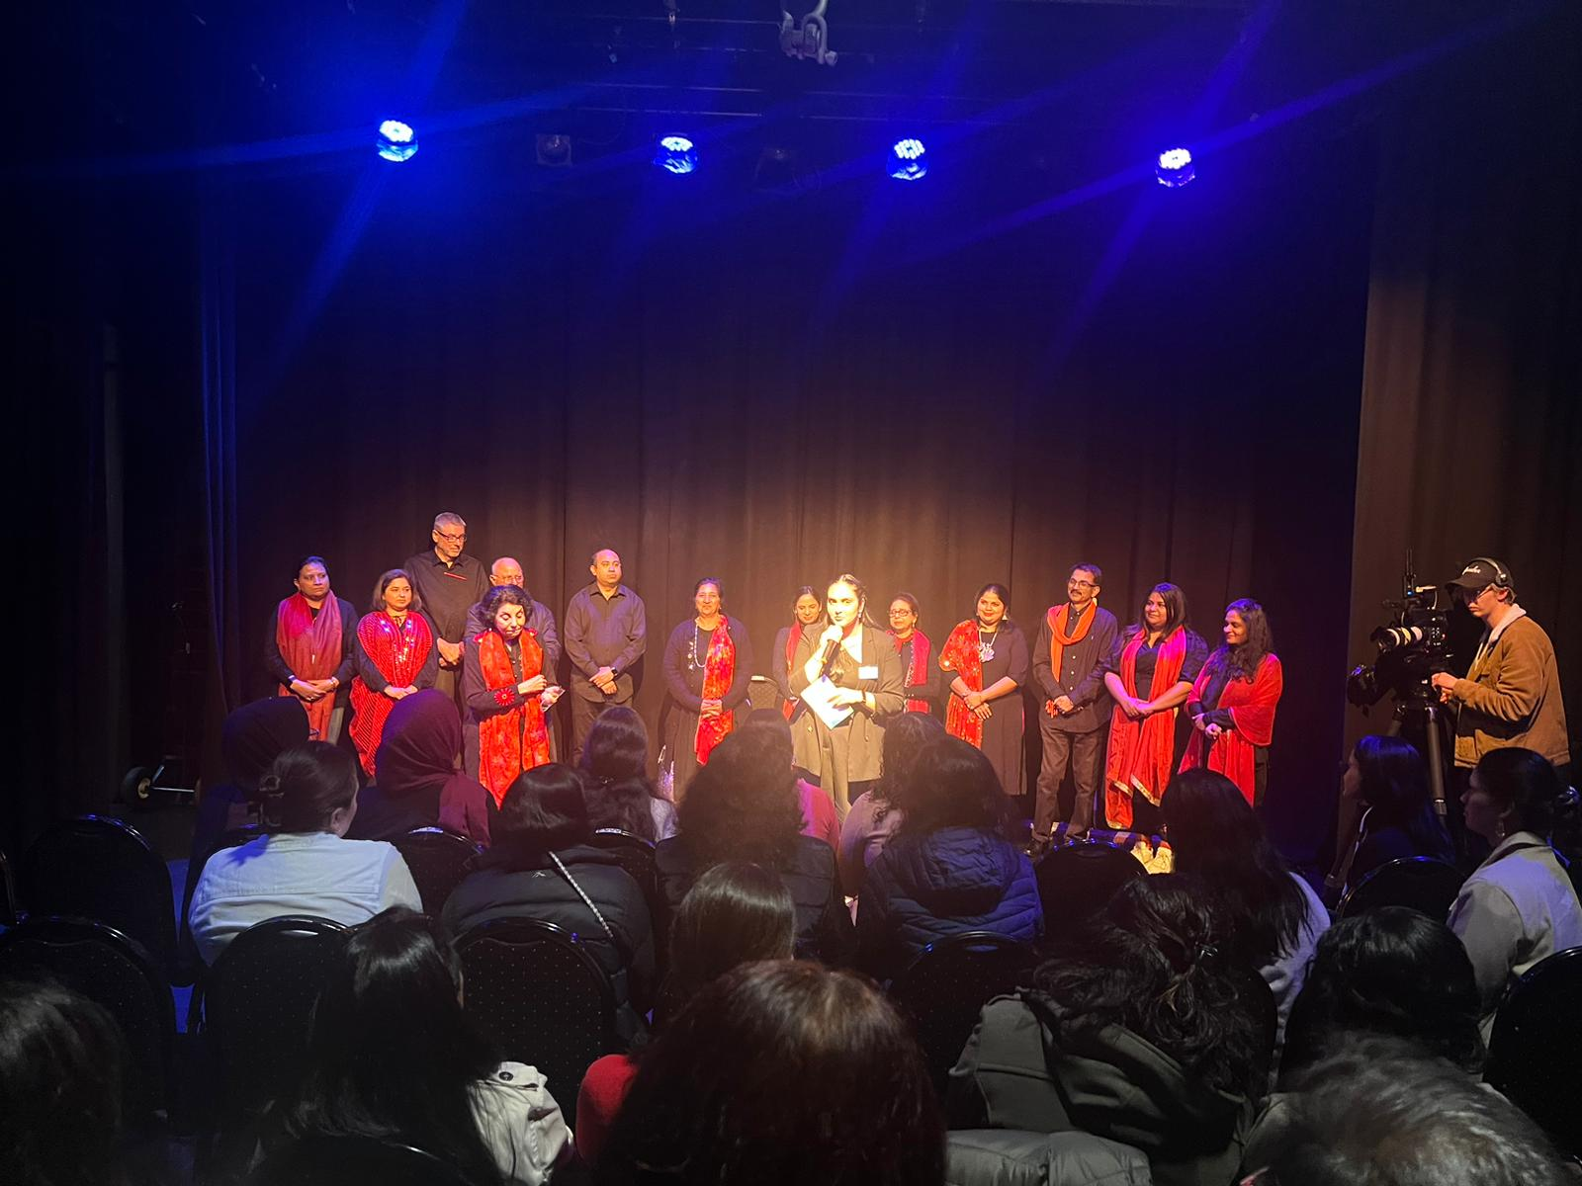
To the final standing ovation

Slide 43
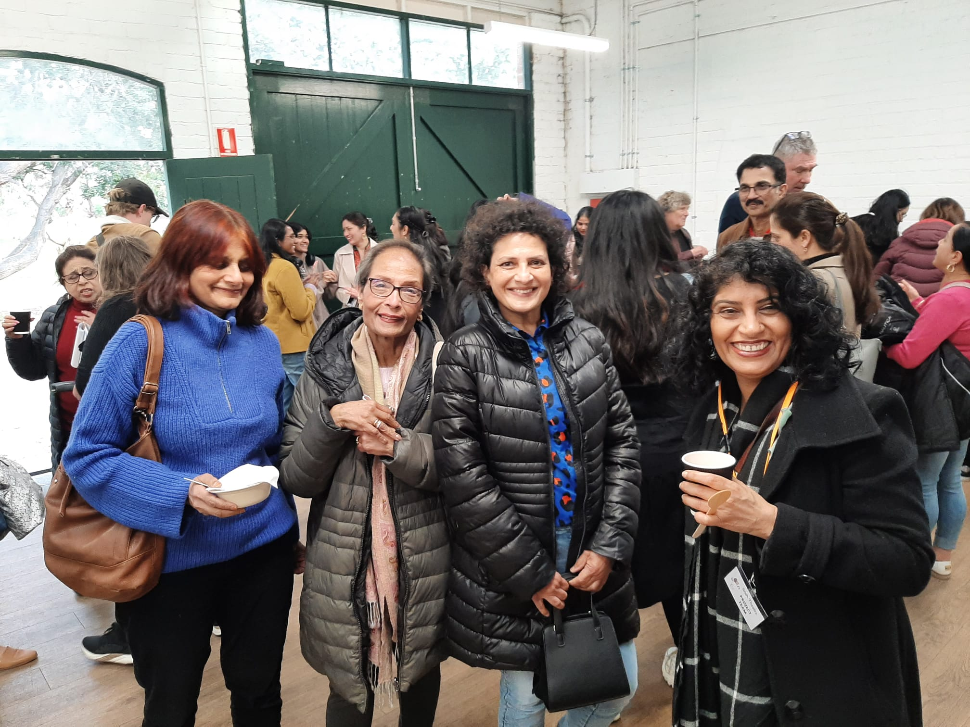
The project brought the community together

Slide 44
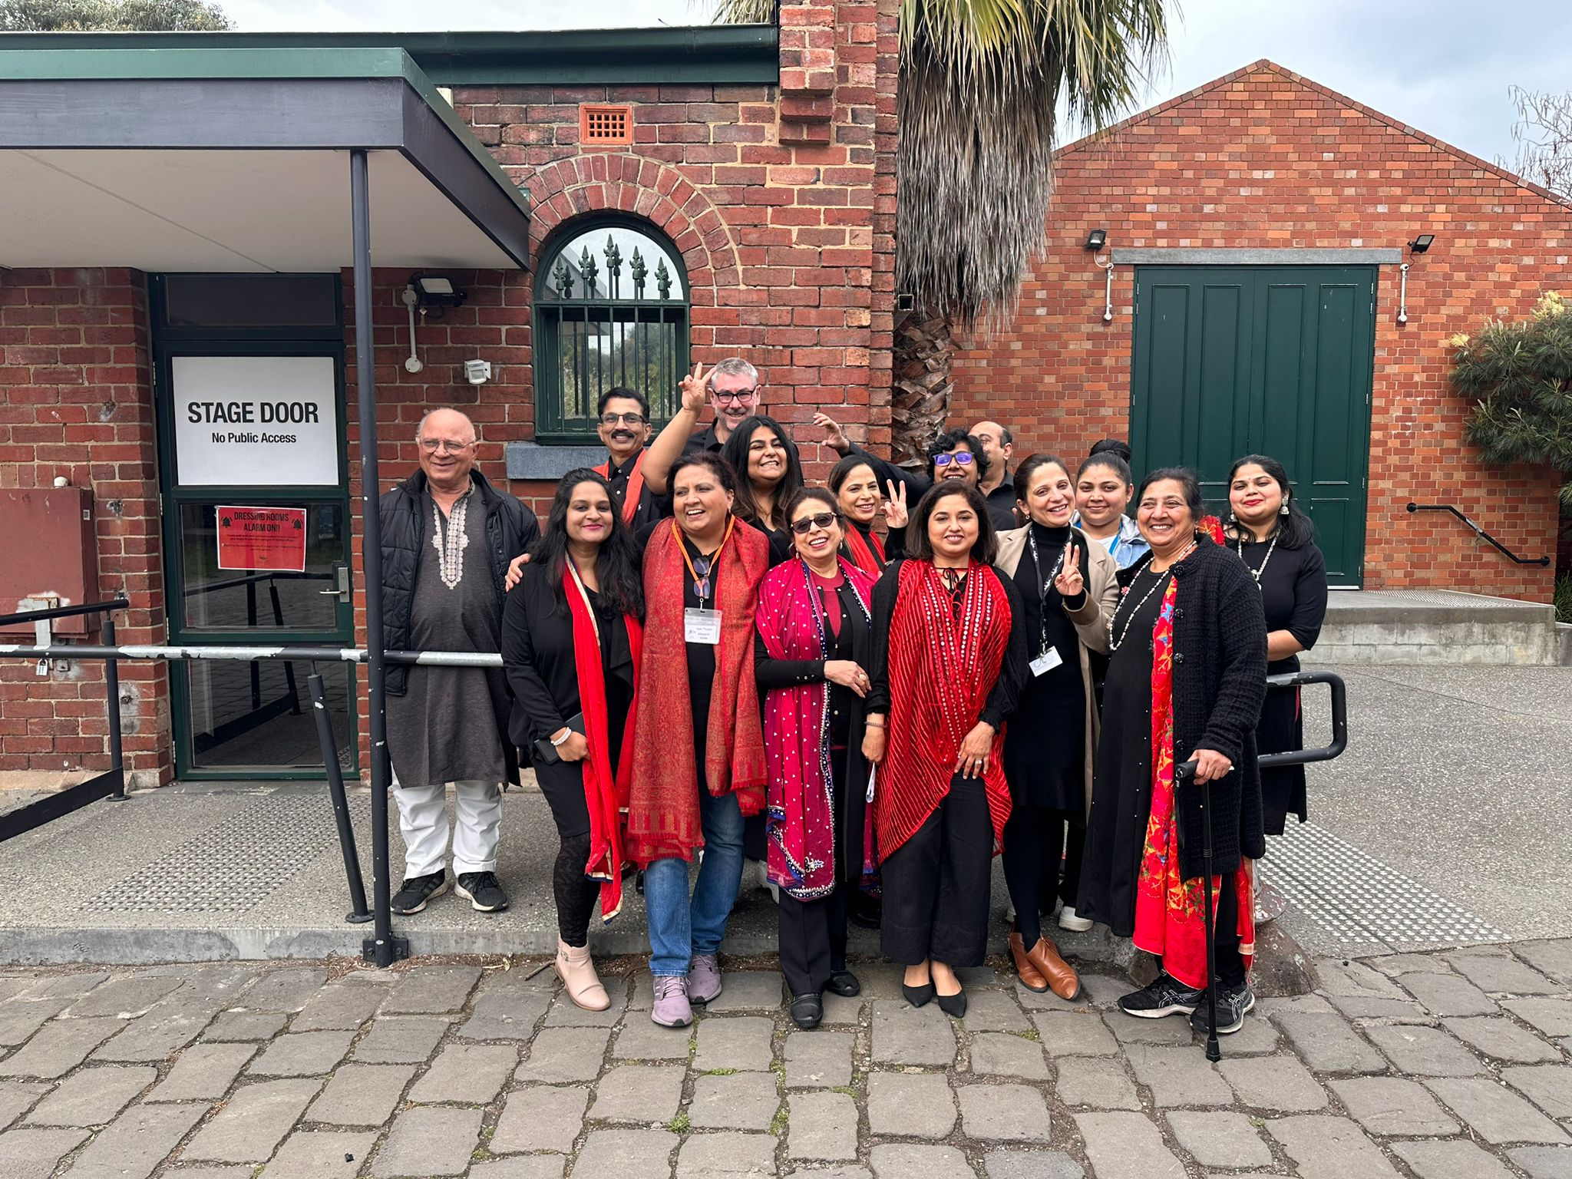
Created an amazing group of actors

Slide 45
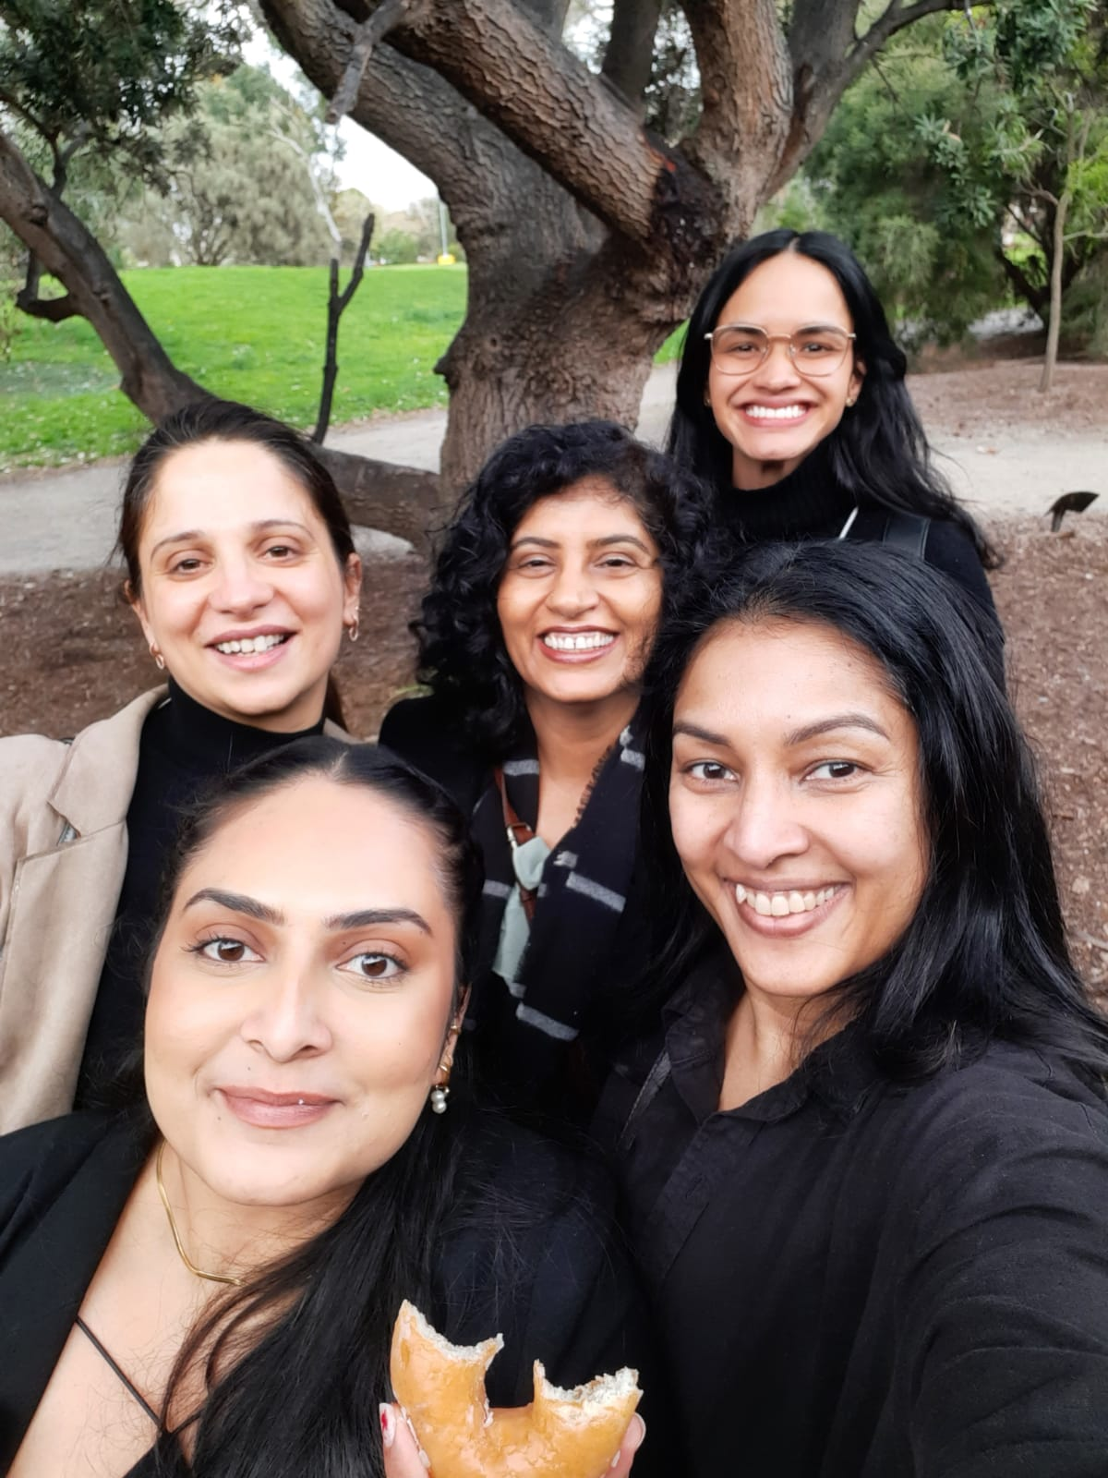
Held together by an amazing Project Team
The team leader managed and coordinated the project team, the theatre cast, the organisation and logistics
Team members contributed to planning, management, communication and promotion, especially through their community and professional networks

Slide 46
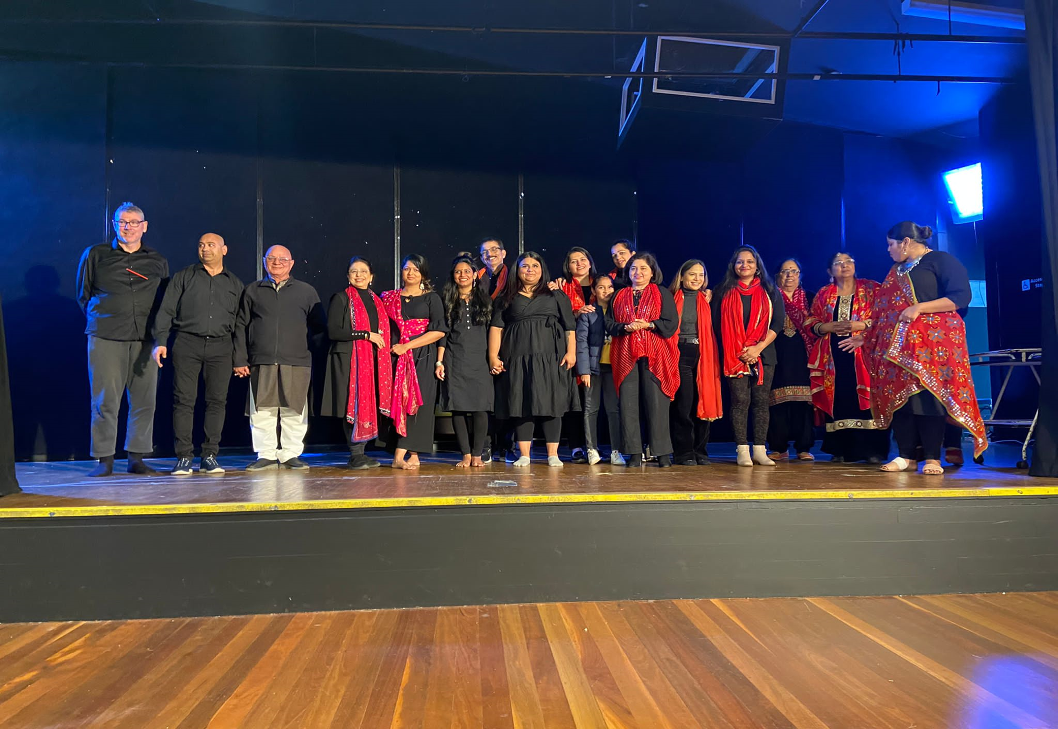
THANK YOU FOR LISTENING

