Slide 1
Dowry Abuse prevention campaign
A grant over three years with Harmony Alliance started in 2020-2022
Project Aims:
Engage and upskill migrant and refugee community leaders to raise awareness of dowry abuse in their communities, counter attitudes that condone violence and increase the ability of community members to address and prevent dowry abuse within their relationships, families, and communities.
To achieve this, the project adopted an intersectional community-led, co-design approach, alongside a culturally tailored, trauma-informed and intersectional method.
In being intersectional, the project acknowledged the diversity of experiences of people from migrant and refugee backgrounds with awareness of the intersecting impacts of gender for women

Slide 2
National Dowry Abuse Prevention Project Outputs
Ran national surveys targetted at:
  the South Asian community around the prevalence of dowry abuse in Australia
  Service providers
Conducted five national online focus groups with South Asian community members
Prepared national workshops titled: “Demand Equality, Not Dowry”
Trained 15 trainers nationally to run the workshops
36 “Demand Equality, Not Dowry” workshops were conducted nationally
Ran a focus group with trainers to reflect on the project outcomes
Produced an academic paper on “Heath Impacts of Dowry Abuse” published 2022 in MJA
Produced a report analysing the themes raised in the focus groups
Grant extended into 2023 -24 to scale up the output to reach thousands

Slide 3
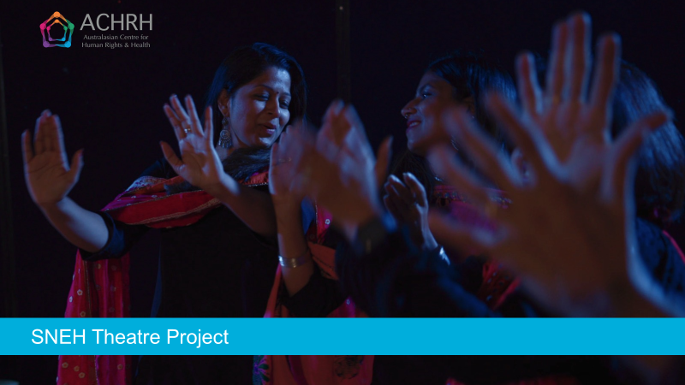
FLAGSHIP PROJECT 2022 - 2024

Slide 4
Supporting Multicultural and Faith Communities to Prevent Family Violence
The Sneh Theatre Project was funded through the Supporting Multicultural and Faith Communities to Prevent Family Violence: 2021 Grant Program under the DFFH
The Program will contribute to the Victorian Government’s vision to create a Victoria free from violence
The program uses Change the Story: A Shared Framework as the knowledge base to guide the scope of prevention activity

Slide 5
About the grant program
The objectives of the Supporting Multicultural and Faith Communities to Prevent Family Violence 2021 Program are to:
deepen and expand primary prevention and early intervention activity
enhance knowledge of successful primary prevention and early intervention activity
strengthen the capacity of organisations
improve the identification and response to victim survivors of violence

Slide 6
About the grant program
The objectives of the Supporting Multicultural and Faith Communities to Prevent Family Violence 2021 Program are to:
deepen and expand primary prevention and early intervention activity
enhance knowledge of successful primary prevention and early intervention activity
strengthen the capacity of organisations
improve the identification and response to victim survivors of violence

Slide 7



SNEH Theatre Project
In partnership with the Oorja Foundation
Film director and photography:
Emma Macey-Storch
Evaluation:
Approved by the Melbourne Clinic Research Ethics Committee
Funded by the Victorian Department of Families, Fairness and Housing under the ‘Supporting Multicultural and Faith Communities to Prevent Family Violence’ Grant Program

Slide 8
Why Community Participatory Theatre?
Based on Forum Theatre, perfected by Augusto Boal (Boal, 1979)
This approach uses CULTURE AS STRENGTH
Working with community and society it is crucial to improve strategies to address issues of social health, moving the locus of control from external agencies to the people who are directly experiencing it.
By bringing the stories of marginalised people on stage, theatre offers a rare opportunity to people on the fringe to be in the centre where, being the experts of their own lives, they can be engaged in a dialogue with the audience to discover and explore collectively how to deal with their own problems.

Slide 9
Creating the foundation of Sneh Theatre
The project first researched and explored the community’s understandings around gender norms, gender equality, and family and domestic violence
Two focus groups were conducted with community members
Key issues identified by the community included:
    Dowry abuse
    Family dynamics
    Migration issues and vulnerabilities
    Impacts of not seeking help
    Gendered drivers of violence

Slide 10
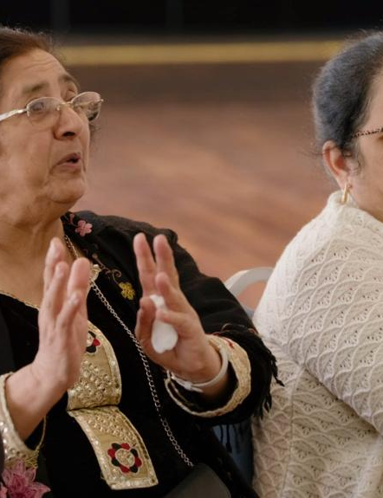
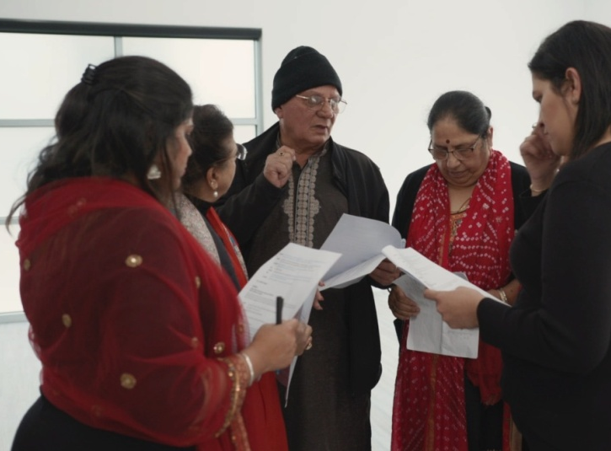
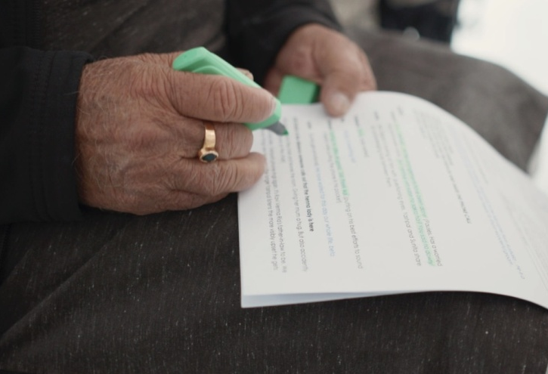
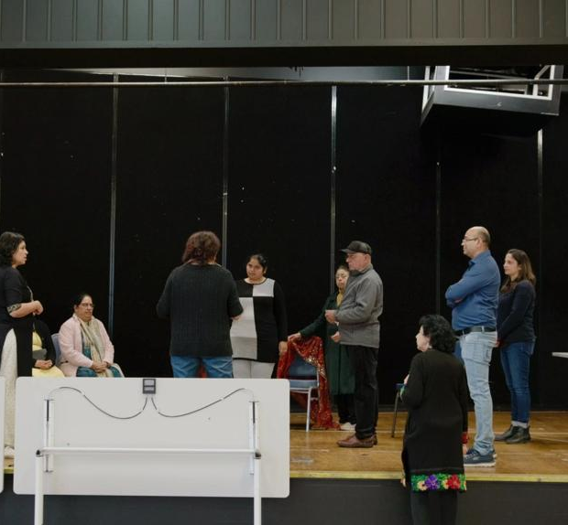
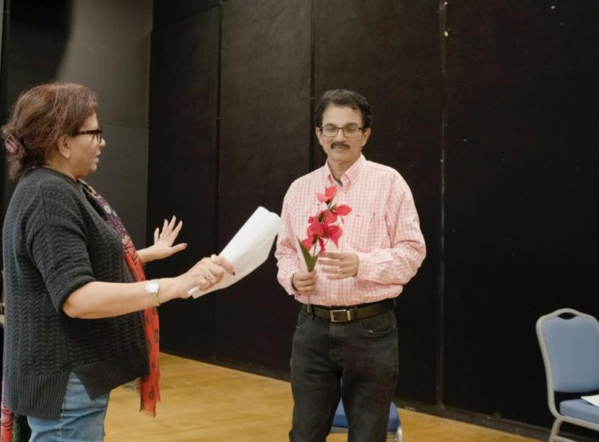
Development and rehearsals
16 volunteer members of the Indian community, together with members of the project team explore themes related to FDV, gender norms, stereotypes and help-seeking
Workshops and rehearsals were run over months, both face to face and online
The workshops dived deep into the themes around early intervention and primary prevention
The purpose of the workshops was to build a trusting theatre ensemble from volunteer participants

Slide 11
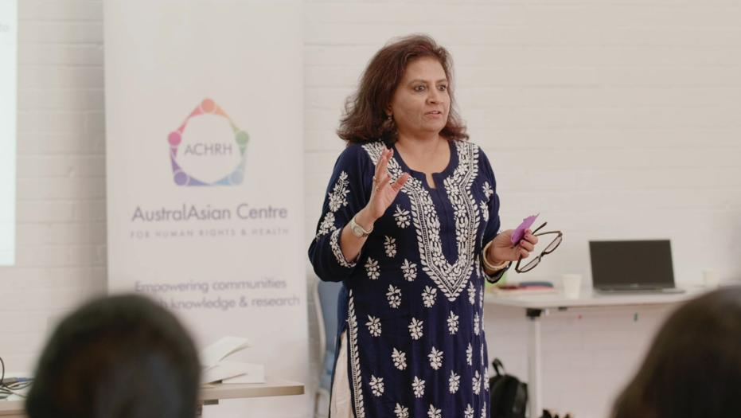
Led by the Theatre Director, and cultural consultants, the group developed and created working scenarios from community and participants’ stories

Slide 12
Three skits were selected for development
Dowry abuse
Migration pressures
Financial pressures that may increase the risk of family violence and the impacts on women and children
Benefits of early help-seeking is a key unifying scheme

Slide 13
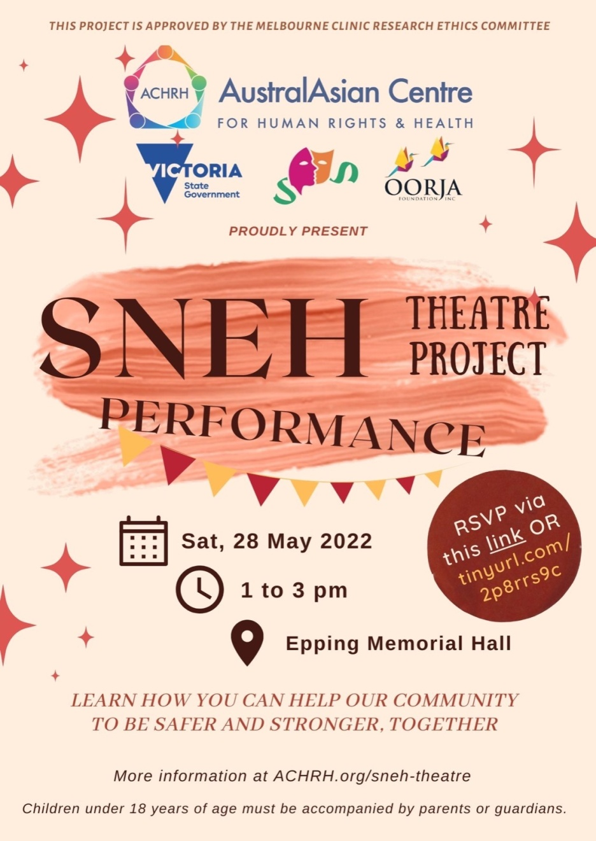
Community performances - 2023
Following three successful performance in 2022, there were
four performances in 2023:
July 2023: Dosa Hut Function Hall, Melbourne
Newbury Community Centre, Craigieburn
Aug 2023: Dianella Community Centre, Tarneit
Sept 2023: Gasworks Theatre, Albert Park

Slide 14
Evaluation - SNEH – by the numbers
2 community focus groups, with 26 participants
9 members on the project team
14 – 19 community volunteers participated in 5 community workshops
7 community performances reaching approximately 200 audience members
Countless project meetings!
Continuous filming with embedded film crew

Slide 15
EVALUATION
Contributing to knowledge and understanding through project evaluation
From 130 audience surveys we have found that:
94% of audience members increased or deepened their understanding of family violence
95% feel it is very important for the community to speak about gender equality
98% feel it is very important for the community to speak up against all forms of family violence – and not sweep things under the carpet

Slide 16
What did the audience members say?
‘Thank you very much for raising awareness and having conversations on violence particularly towards women. Hopefully this will get people in general to self reflect and look for ways to improve their selves and be a better example for family and community.’
‘It is an incredible initiative to create awareness.’
‘This is a great initiative. Many many more are needed to even make a dent in the societal mindsets and prejudices.’

Slide 17
Messages audience members took from the performance
‘Speaking up for yourself but also for others is important’
‘The interrelationship between racism, violence, culture, family, social pressures and gender’
‘Don’t stand by when you see domestic violence.’
‘Family Violence can take many forms and is a social issue we need to address, whether for ourselves or someone else in the community.'

Slide 18
From the first workshop…

Slide 19
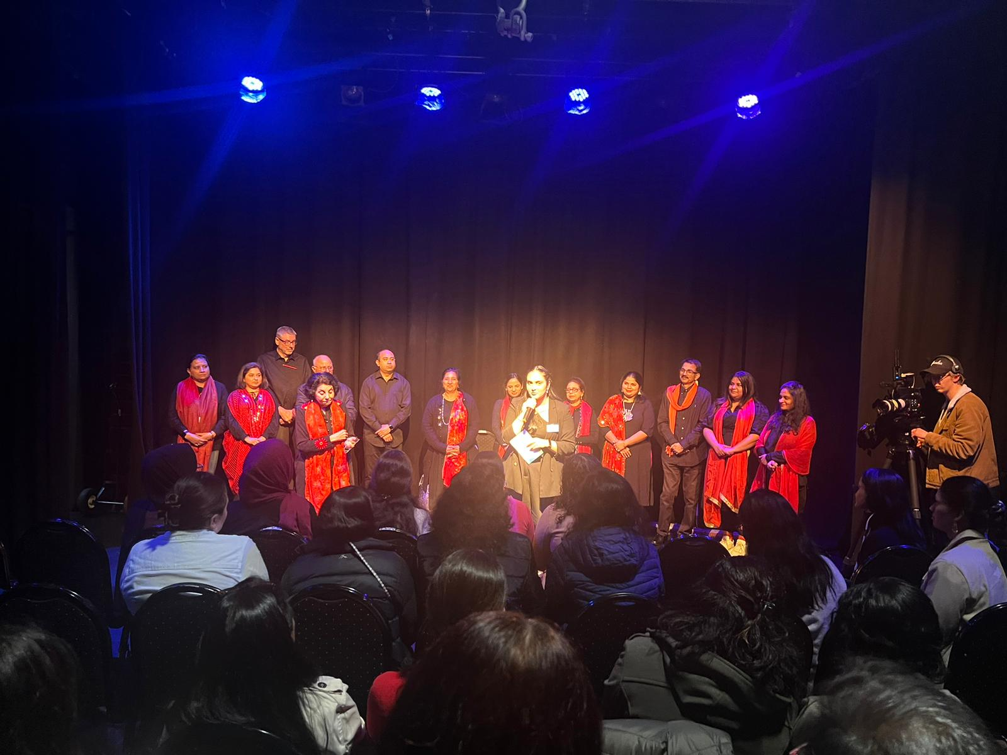
To the final standing ovation

Slide 20
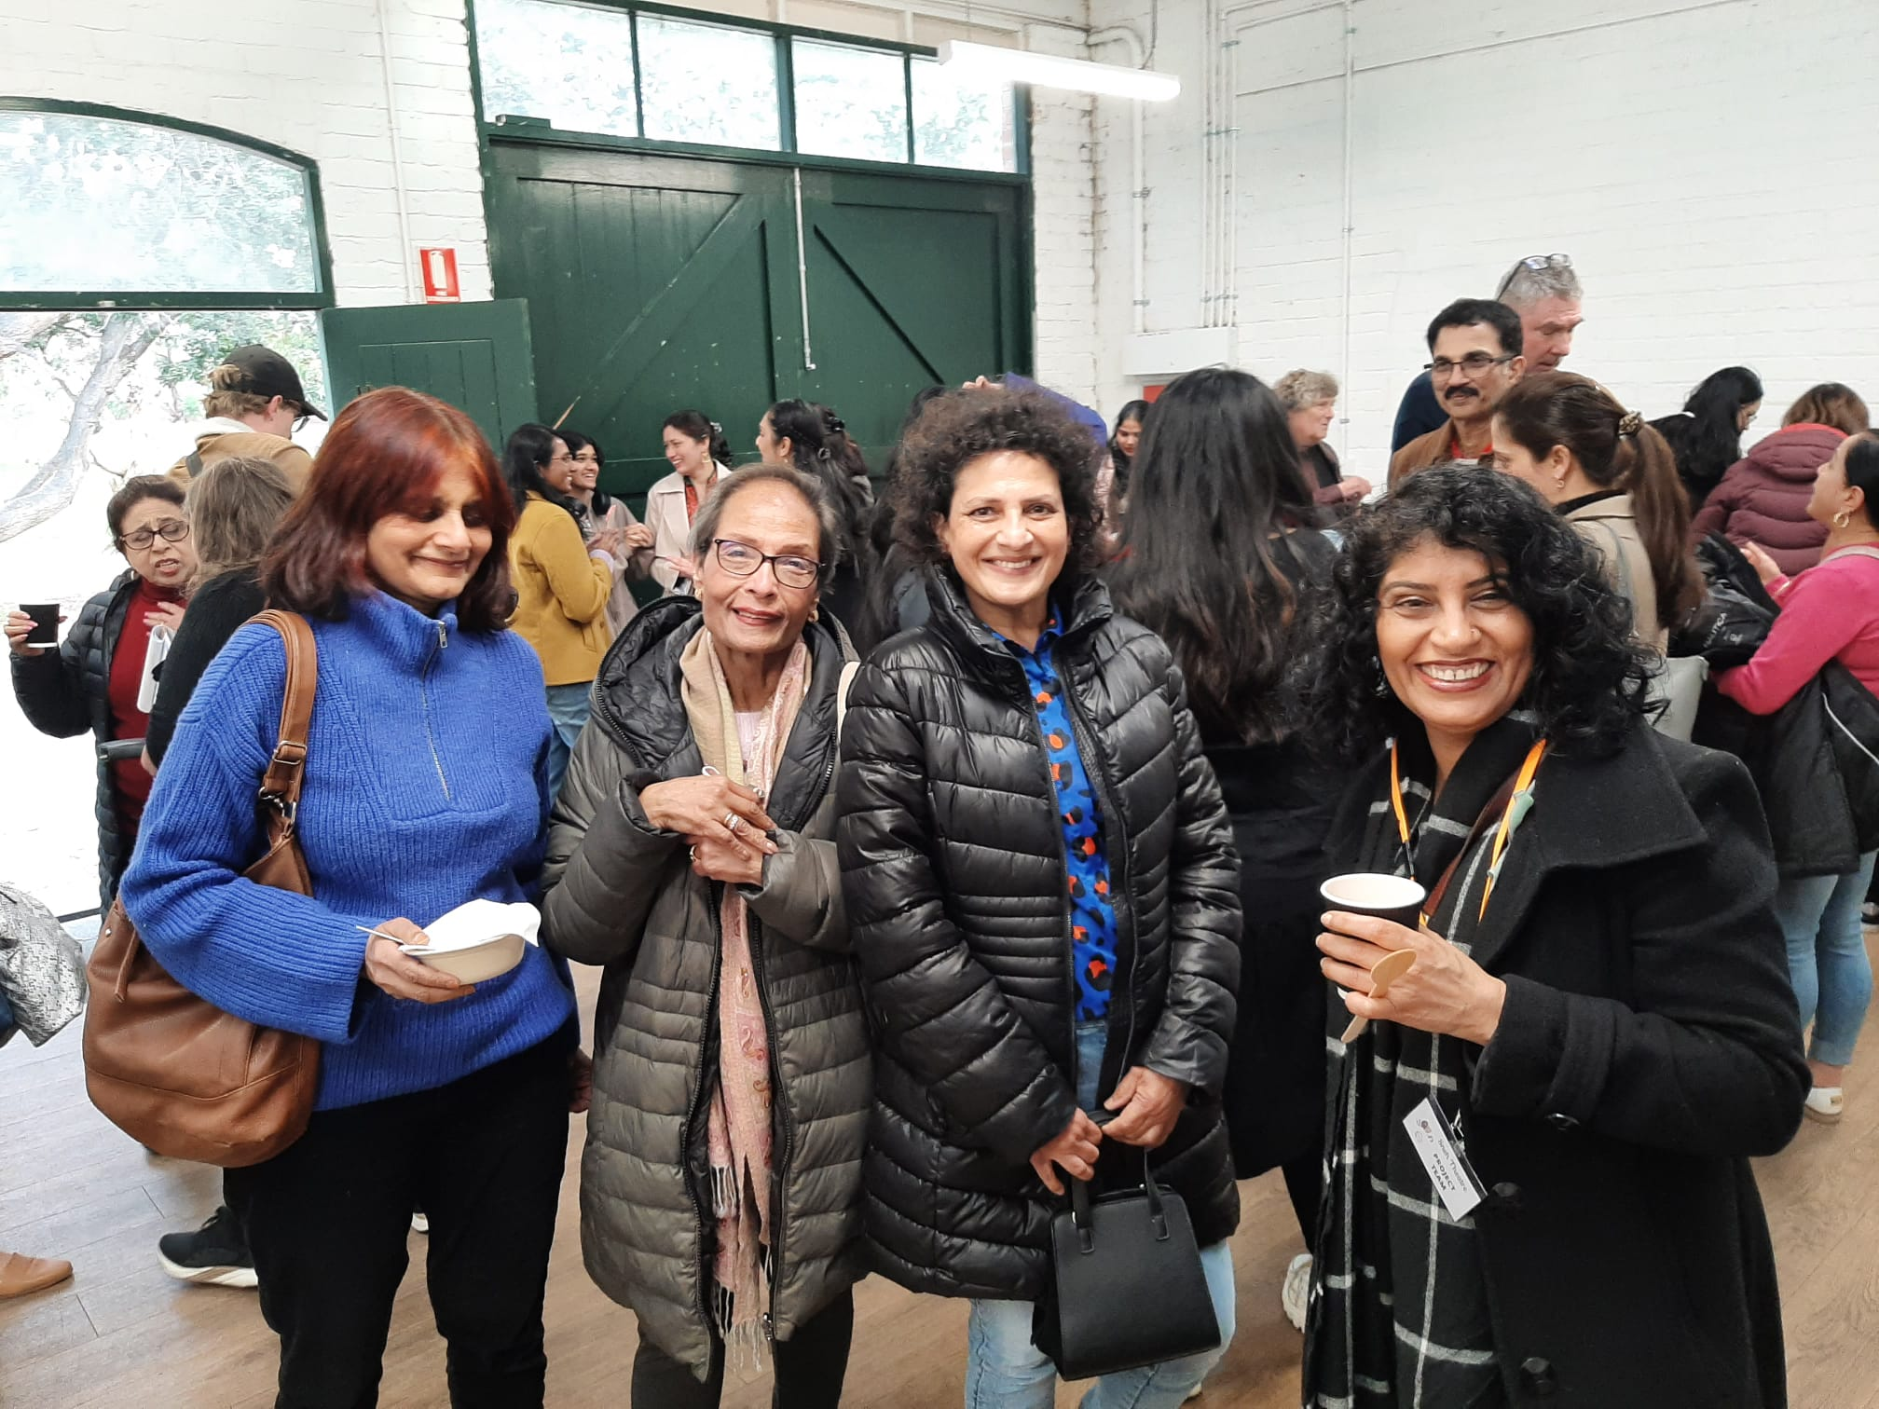
The project brought the community together

Slide 21
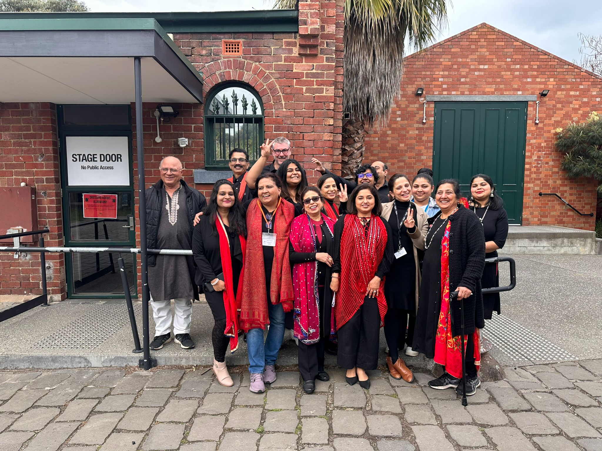
Created an amazing group of actors

Slide 22
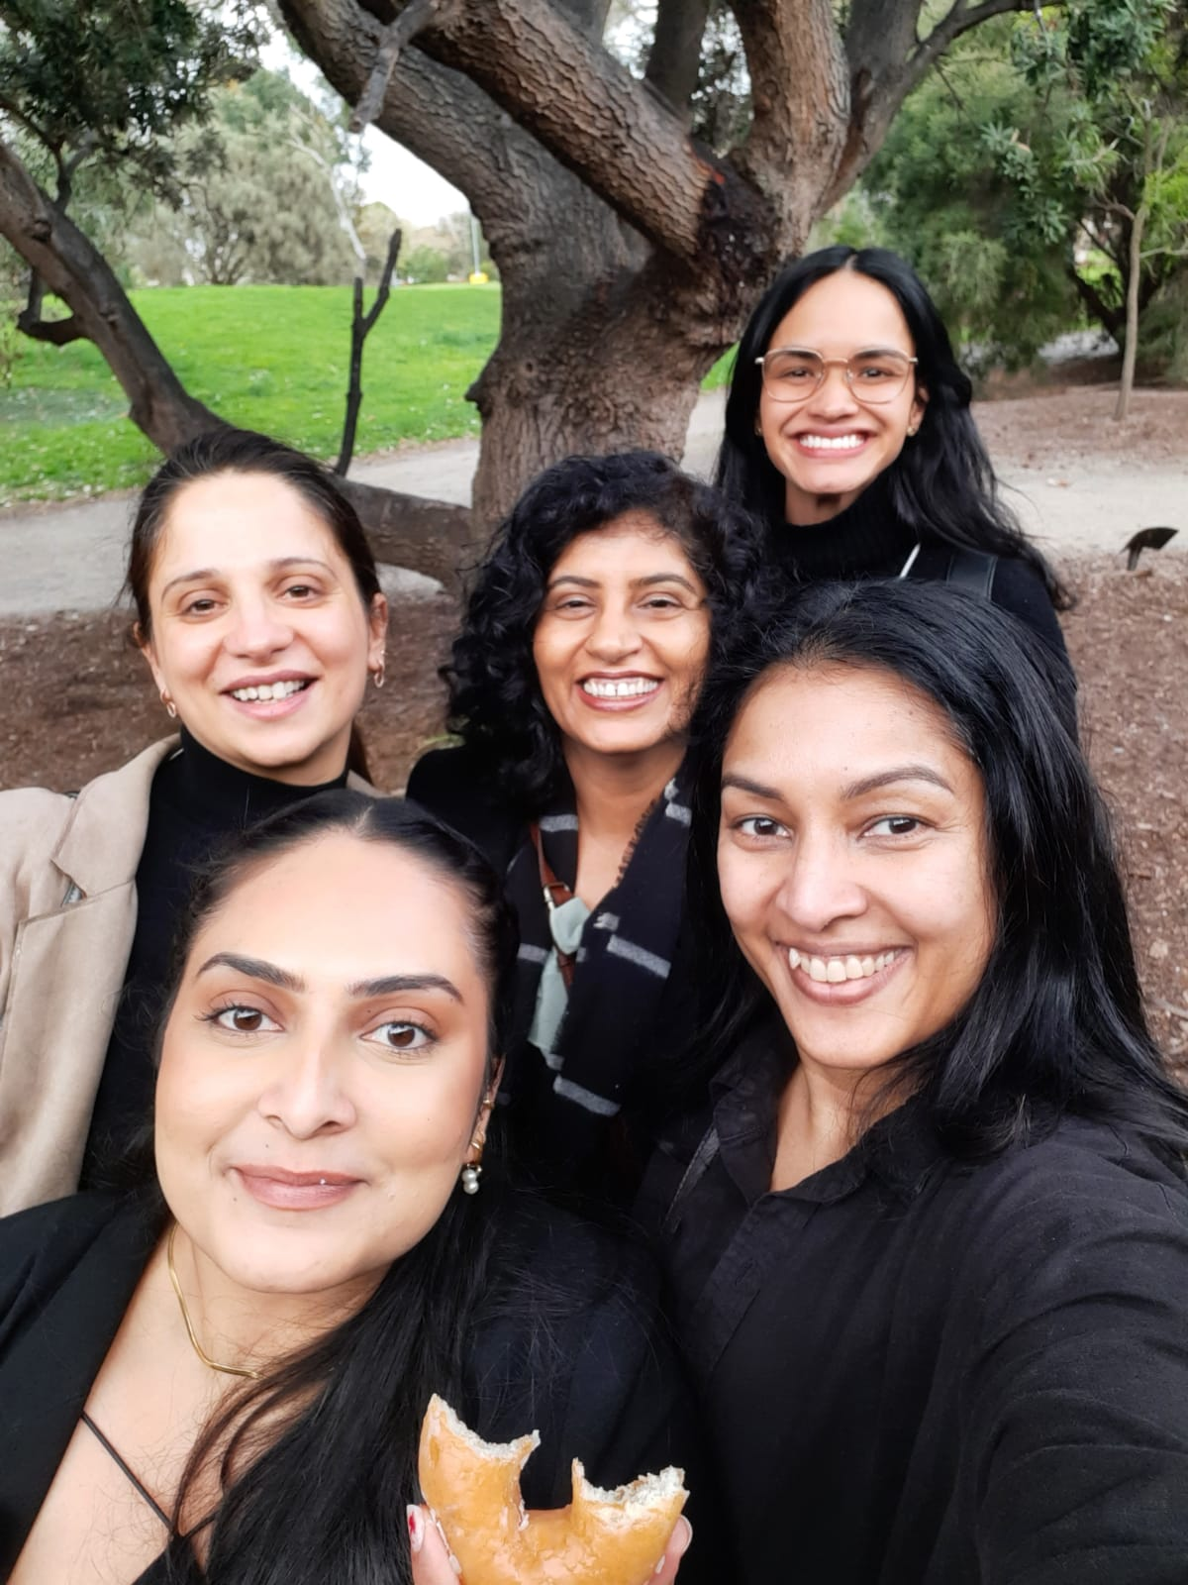
Held together by an amazing Project Team
The team leader managed and coordinated the project team, the theatre cast, the organisation and logistics
Team members contributed to planning, management, communication and promotion, especially through their community and professional networks

Slide 23
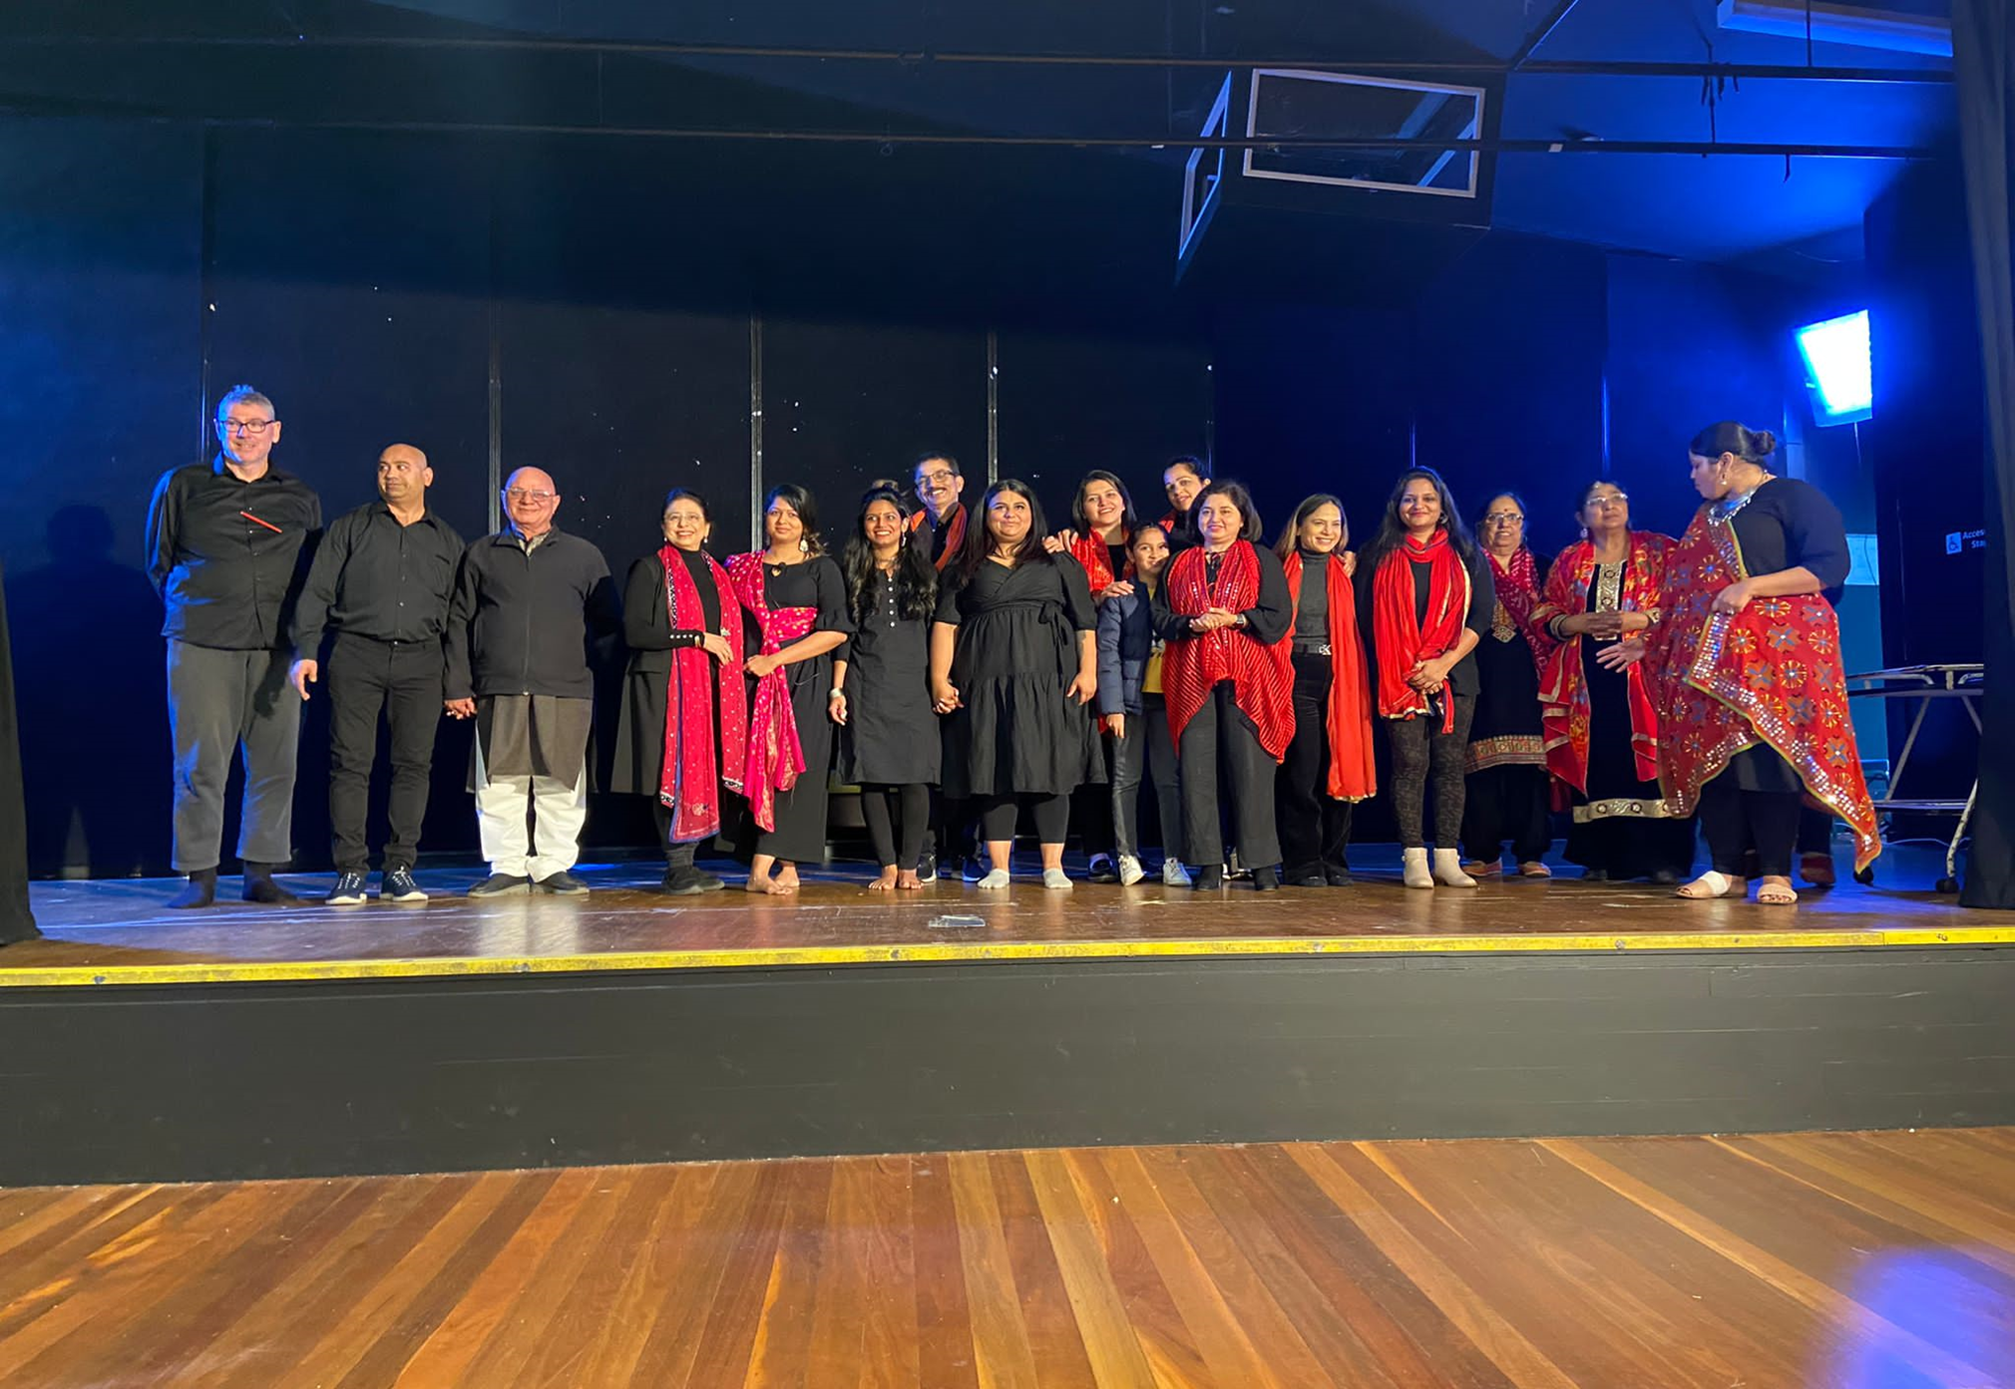
THANK YOU
FOR LISTENING

