Slide 1




AGM
ANNUAL REPORT
2025

Slide 2



CHAIRMAN’S REPORT
PROFESSOR IAN HOWIE

Slide 3

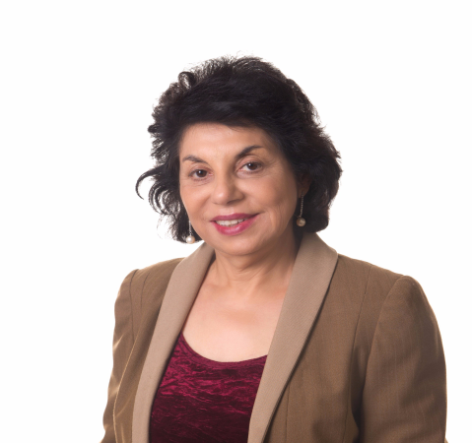
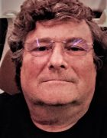
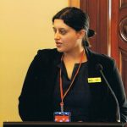
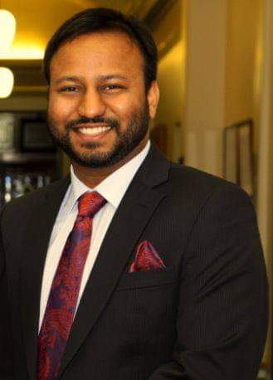
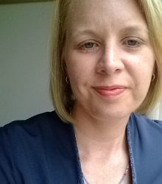

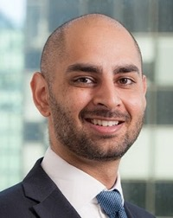
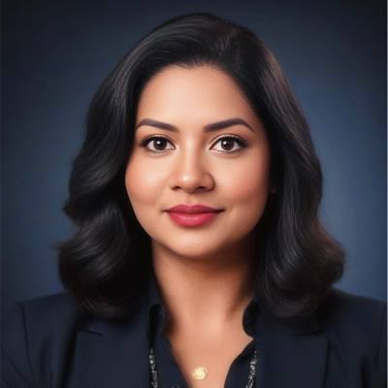
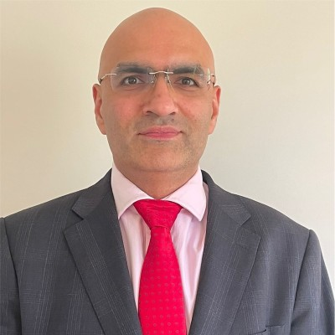
ACHRH BOARD 2023-2026

Slide 4

Audited Income and Expense Statement
For the year ended 30 June 2025

Slide 5
Thanks to Mr Varun Sehgal –Accountant and Board Member for preparing the financial statement .

Slide 6
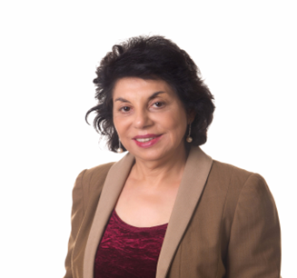
EXECUTIVE DIRECTOR ‘S REPORT
PROFESSOR MANJULA
DATTA O’CONNOR

Slide 7
AustralAsian Centre Visiosn and Misison
Create a happy and harmonious society
Prevent Family Violence in South Asian Communities
Promote Mental Health
Mission –How?
  Action Research and evidence -based community education programs
  Collaborate with community organisations and key stakeholders
  Engage with Government agenises
  Make submissions
  Lobby politicians and key stakeholders
  Engage with Media

Slide 8
ACHRH pioneer on exposing dowry abuse and inclusion in policy, laws, services
Dowry Abuse campaign initiated in 2012 with a petition signed b y 600 community members to include dowry abuse in the Vic FV Protection Act
Dowry abuse recognized in the Victorian FV Prevention Act 2019 , and in WA Legislation
August 2024- Federal Family Law Amendment Bill includes dowry abuse under Economic abuse, passed by the Senate November 2024 . It will receive Royal Assent in early 2025.

Slide 9
Impacts of the dowry abuse laws
Enhanced financial disclosure: The amendments elevate the importance of financial disclosure, requiring parties to fully disclose their circumstances, including the details and implications of dowry-related conduct.
Empowered advocacy: The reforms provide a greater opportunity for victims to have the economic abuse they have suffered formally recognized and advocated for in and out of court.
What this means for those experiencing dowry abuse
Legal recourse: Victims can seek a more just and equitable property settlement by having the financial abuse they endured formally recognized by the court.
Support for future needs: The impact of the abuse on their ability to contribute to the relationship and their ongoing financial needs can be taken into account by the court.

Slide 10
The inclusion of dowry abuse in Australian Federal Family Law Act , effective from June 10, 2025, has a significant impact
Expanded definition of family violence: Dowry abuse is now explicitly included as an example of economic and financial abuse in the Family Law Act 1975. This includes coercing someone to give or seek money, assets, or items as dowry, or coercing them to agree to such terms.
Impact on property settlements by formally recognizing it as a form of economic or financial abuse within the definition of family violence. This allows courts to consider the effect of dowry abuse when dividing property, ensures full financial disclosure in such cases, and enables more appropriate decisions regarding a party's future needs.
Consideration in property division: The impact of family violence, including economic abuse like dowry abuse, is now a relevant consideration when a court divides property and finances after a relationship breakdown.
Impact on contributions and needs: Courts can consider how controlling and coercive behaviors, such as those associated with dowry abuse, have affected a party's contributions to the relationship and their future needs. This can lead to more equitable outcomes in property division.

Slide 11
Achrh - National dowry abuse working group Chair
.Membership- Good Shepperd , Intouch Multicultural centre, Harmony Alliance and UNSW
The group TOR include- highlight the nature and impact of dowry abuse , prevention of dowry abuse, encourage research in dowry abuse , highlight Gaps in national and state-based data collection
advocating for legislative changes to include dowry abuse at Federal level and States.
Regular meetings are held with relevant Govt authorities and Attorneys General .

Slide 12


Slide 13
ACHRH –Temp visa holders advisory and collaboration
ACHRH is member of the National Advocacy Group to advocate for victims of family violence on TEMPORARY VISAS
The membership of the group consists of a larger general group comprising about 50 national members –core DV service providers , researchers and NGO s
And a smaller Executive group. ACHRH is a member of both groups
The Group has had a significant impact on the policy

Slide 14
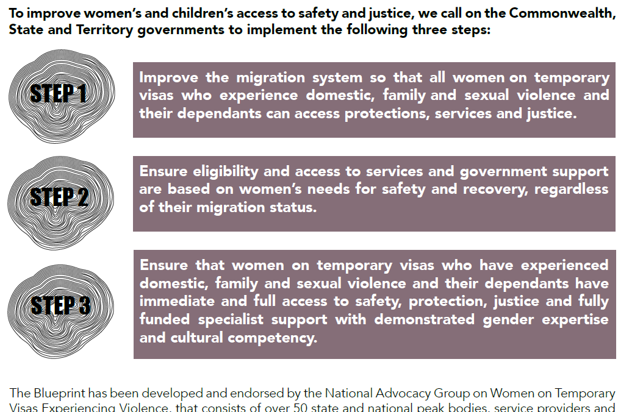

Slide 15
Advocacy and Results
Executive members - ACHRH Members with Monash Uni And Melbourne Uni , InTouch , Women's Legal service . We regularly meet, plan and advocate
RESULT
Temp visa victims no longer deported immediately
They can stay and fight their family property cases
If they had partner visa application n and sponsorship withdrawn that application is considered valid, and they get their permanent residency
Medicare support immediately
Legal Aid support
Housing support
$5000 CASH support

Slide 16
Some Missing Gaps Filled Some Not
International brides or defacto partners whose partner visa application is not in train, and arrived on Temporary visa are not allowed permanent residency visa- IMPROVED –Many VICTIMS SURVIVORS ARE NOW GETTING PR- even if on tourist visa but only of the husband is Australian citizen or PR
They usually end up applying for Protection Visa or International Student Visa , or marry someone local with residency visa
We are still requesting a special family domestic violence visa to be initiated for such women.
NO Social Husing for FV victims on temporary visas – we are starting a new advocacy campaign

Slide 17
Community Educational Projects 2024
Film FINDING AFFECTION 2024
Screened at Indian Film Festivals Melbourne, Kolkata
Received Award Durga Film Festival Kolkat , appreciation certificate at San Francisco Women's only Film Festival
August 2025 – Film screened at “Seen and Heard” Film Festival Mount Waverly
September 2025- Film screened at Community Lawyers Conference Canberra
October 2025 – Held educational film screening workshop with Australian Indian Medical Group Sydney
Planned screening to mark 16 Days of Activism in Parramatta Sydney on 4/12/25
Open to invitation to screen the film for any community or professional group

Slide 18
Going Forward
Number of projects in pipeline
  Continue building partnerships –IndianCare, Lotus Films and Kheliya Productions
  Mental health intersection with family violence
  Youth mental health - exposure to sexual and family violence

Slide 19


THANK YOU FOR LISTENING

